Slide 1


Lesson 49:
Arithmetic sequences
Objectives
Understand the concept of arithmetic sequences
Derive the nth term of sequences generated from
a context
Apply nth term formula in both theoretical and
practical contexts
Notes:
Explain that the activities will enable learners to draw on prior knowledge of sequences, using a realistic, practical context to build confidence and understanding.

Slide 2

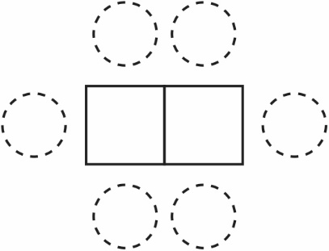
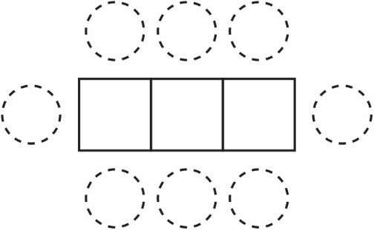
Discuss 1: How many tables do they need?
DISCUSS
A café organises square tables and circular chairs like the diagrams below.
Ruby and Dev work at a café. Dev says that he has worked out a formula to calculate how many people can be seated around different numbers of tables when they are put together:
“We need n + 3 chairs where ‘n’ represents the number of tables.”
Ruby thinks Dev is wrong. What do you think?
Notes:
Discuss in pairs and answer the following questions:
How many chairs would they need for 8 tables? How many for 12 tables?
With this arrangement how many tables would they need for 37 chairs?

Slide 3
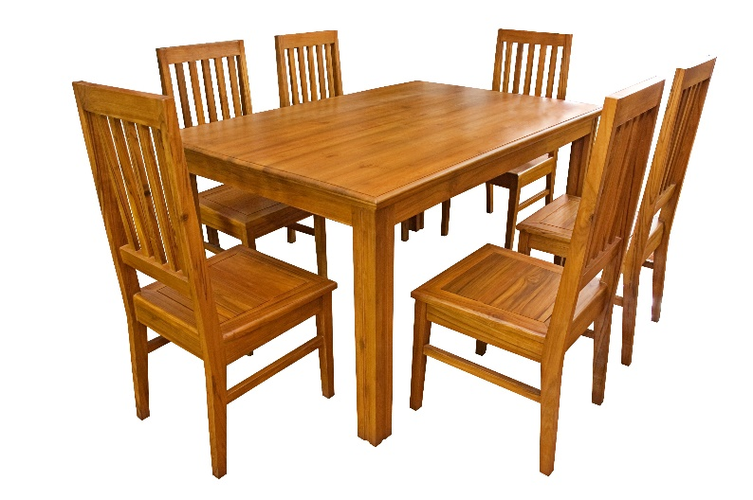
Explore 1: Tables and chairs
EXPLORE
How many people fit around this table?
Using the same arrangement, how many people fit around
2 of these tables when put together as shown?
Record your results using a diagram like this one.
Notes:
Practical task:
Ask learners to work together in arranging chairs around 1 table, 2 tables and 3 tables put together horizontally and record their results.
Nominate a learner to present results on the board.

Slide 4
Discuss 2: Tables and chairs
Spot the pattern
6, 10, 14
How many chairs are needed for 4, 5 and 6 tables?
How many chairs are needed for 10 tables?
1st term
3rd term
Notes:
Emphasise that each number in the pattern (sequence) is called a term.
Ask learners the relationship is between the table (position) and number of chairs (terms).
First term represents number of chairs around one table (i.e. position 1).
Third term represents number of chairs around three tables (i.e. position 3).
Model the correct language, e.g., if terms are next to each other, they are referred to as consecutive terms.

Slide 5

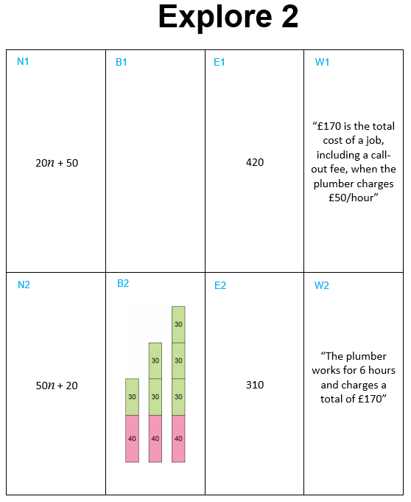
Explore 2: Setting the scene
Handout
available
Ruby and Dev are comparing the cost of employing plumbers to complete some work in the bathroom.
They need to calculate the total cost of the refurbishment, which includes a call-out fee and an hourly rate for labour.
Working in pairs, take turns to match the set of cards given to the sequence shown on the template.
For each match, the first person must explain their reasoning. The second person must agree/disagree/ask for more explanation.
Notes:
Introduce the context of the cost of employing a plumber who charges an hourly rate and a call-out fee. Learners work in pairs and are instructed to take turns to match each card to a sequence on the template and explain their reasoning to their partner.
Teacher is to cut out the cards on the ‘Explore 2’ handout. Only give out the N cards to start. Laminating these cards and the template sheet will enable re-use of the resource.
Issue the template and first set of cards (labelled ‘N_’), giving the nth term expression/formula to each pair of learners. There are 6 cards in the set, and 8 gaps on the template.
Move around the room, asking individual learners to identify which card they placed and why. Point out to learners that they need to determine the nth term for two missing cards. Ask questions relating to the context, e.g. ‘What is the hourly rate for this sequence?’ ‘How do you know that the call-out fee is £x?’
Tutor to give out the second set of cards (B):
Introduce the second set of cards showing bar models of cost structure (labelled ’B_’). Note that learners might match each card to just one other card and not check that all pairings make sense. The visual representation may provoke cognitive conflict. Again, point out to learners that they need to create bar models for the two missing cards.
Tutor to give out the next set of cards (E):
Issue the third set of cards with the value of the eighth term (labelled ‘E_’). Note that one of the cards has a value that is double the value of the 4th term of a different sequence to illustrate a common misconception.
Tutor to give out final set of cards (W):
The final set of word cards, referring to context (labelled ‘W_’), can be issued. Note that two of the sequences have two word cards that match.

Slide 6
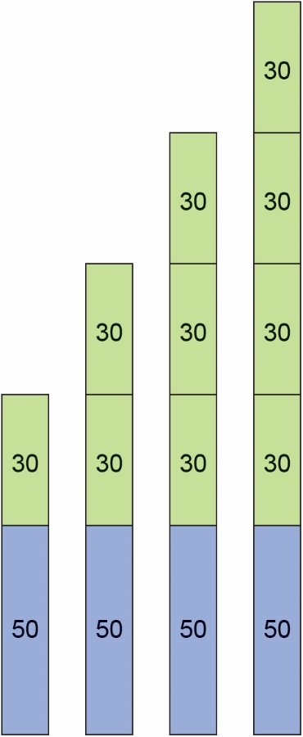
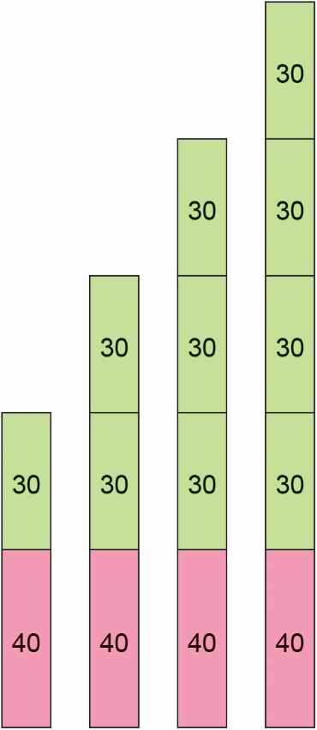
Review: Cost of a plumber
Notes:
Ask learners for key learning points and reinforce correct mathematical language. (See NCETM KS3 guidance notes on language).
Ask learners to describe the nth term formula for each model.
‘How do you know which part of the diagram represents the call-out fee?’
‘What would the total cost be if the plumber didn’t charge for labour?’
‘How would the nth term formula change if, due to an increase in fuel prices, the plumber decided to increase his call-out charge to £50?’
‘How would the nth term formula change if the plumber decided to increase his labour charge to £40 per hour?’

Slide 7
Plenary: nth term
Look at the following sequence
70, 100, 130, 160
Make sense of these in terms of the context.
What is the rule?
So we can write this as 30n + 40
× 30 + 40
Notes:
Use slide 7 to introduce zero term position. ‘What would the total cost be if the plumber did not charge for labour?’
‘How would the nth term formula change if, due to an increase in fuel prices, the plumber decided to increase his call-out charge to £50?’
‘How would the nth term formula change if the plumber decided to increase his labour charge to £40 per hour?’

Slide 8
nth term 1
Look at the following sequence
3, 7, 11, 15, 19, ....
What is the rule?
4n − 1
Notes:
Use slides 8 and 9 as practice for the class and more class discussion.
Teacher to work through this example with the class.

Slide 9
nth term 2
What about when the sequence decreases?
What is the nth term of these sequences?
  2, 0, -2, -4, ...
  0, -3, -6,-9, ...
Notes:
Teacher to work through examples with the class.

Slide 10
Exam question 1
PRACTICE
Worksheet
available
Here are the first four terms of a number sequence.
3 7 11 15
(a) (i) Write down the next term in the sequence.
(ii) Explain how you got your answer.
(b) Work out the 11th term in the sequence.
(c) Is 79 a term in this sequence?
Explain how you got your answer.
Notes:
Learners try this question.

Slide 11
Exam question 2
PRACTICE
Here are the first five terms of a number sequence.
45 40 35 30 25
(a) (i) Write down the next two terms of this sequence.
A term of this sequence is −5
(ii) Which term?
The nth term of a different sequence is given by the expression 4n + 3
(b) Find the 9th term of this sequence.

Slide 12
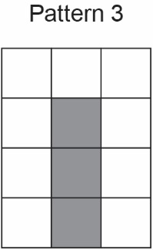
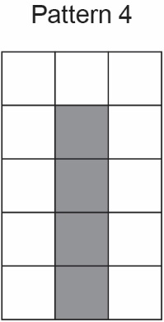
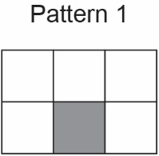
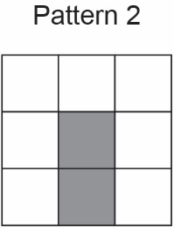
Exam question 3
PRACTICE
Worksheet
available
A sequence of patterns uses grey squares and white squares.
Here are the first four patterns.
(a) Work out the total number of squares in Pattern 100
(b) Complete this number machine for the sequence of patterns.
Notes:
Learners try this question.

Slide 13
Exam question 1: Answers
REVIEW
Worksheet
available
Here are the first four terms of a number sequence.
3 7 11 15
(a) (i) Write down the next term in the sequence.
19
(ii) Explain how you got your answer.
Add 4 each time
(b) Work out the 11th term in the sequence.
43
(c) Is 79 a term in this sequence?
Explain how you got your answer.
Yes, 1 less than 80 and 80 is a multiple of 4
Notes:
Part c:
Explanations from mark scheme:
1 less than 80 and 80 is a multiple of 4
Generate series to 79
79 is the 20th term
Accept equivalent answers

Slide 14
Exam question 2: Answers
REVIEW
Worksheet
available
Here are the first five terms of a number sequence.
45 40 35 30 25
(a) (i) Write down the next two terms of this sequence.
20, 15
A term of this sequence is −5
(ii) Which term?
11th term
The nth term of a different sequence is given by the expression 4n + 3
(b) Find the 9th term of this sequence.
4 × 9 + 3 = 39
Notes:
Learners try this question.

Slide 15
Exam question 3: Answers
REVIEW
A sequence of patterns uses grey squares and white squares.
Here are the first four patterns.
(a) Work out the total number of squares in Pattern 100
3n + 3 is nth term.
3 × 100 + 3 = 303
(b) Complete this number machine for the sequence of patterns.
× 2 + 3

Slide 16
Lesson review:
Arithmetic sequences
Objectives
Understand the concept of arithmetic sequences
Derive the nth term of sequences generated from
a context
Apply nth term formula in both theoretical and
practical contexts
Suggested further steps/areas to work on
Solving equations; finding coordinates for a
straight-line graph

Slide 17
Lesson 49:
Credits
Text acknowledgements
Slide 10: Pearson Edexcel GCSE (9-1) in Mathematics 1MA0/2F June 2015, Question 13
Slide 11: Pearson Edexcel GCSE (9-1) in Mathematics, 1MA1/3F November 2020, Question 12
Slide 12: GCSE Maths AQA Foundation Specimen Paper 3, 2015, Question 11
Photo acknowledgements
123RF.com: Nuwat Chanthachanthuek

