Slide 1


Lesson 43:
Graphs and charts
Objectives
Read and interpret pictograms, bar charts and pie charts
Understand common errors when constructing graphs and charts
Construct pie charts.

Slide 2
Say what you see
INTRODUCTION
Total medals won by four countries in the 2016 Rio Olympic Games.
Brazil
Kenya
Jamaica
South Africa
Key : represents 4 medals
Notes:
Start by asking the learners what they see on the slide.
You may get answers such as ‘a list of countries and some circles’ to start with. Probe for what type of charts it is (a pictogram), and what the circles could represent. What about the quarter, half and there-quarter circles?
Ask what’s missing from the pictogram? What needs adding to help makes sense of it? (Probe for a key and a title)
Next, click to reveal the key and ask the class what this tells them. Again, probe to get as many ideas as you can from the class, e.g. What sort of medals might they be? Can learners say how many medals have been won or awarded to each country? Emphasise the importance of a key on a pictogram (and on some other charts)
Next, click to reveal the title. Ask if this helps learners make more sense of the pictogram. What events do they think Jamaica won medals for? What about Kenya? Emphasise the importance of a title on any graph or chart.
Finally, ask the learners who might want to know this information and why? Why do we use charts such as pictograms to present information?

Slide 3
What’s the same and what’s different?
DISCUSS
Brazil
Kenya
Jamaica
South Africa
Key : represents 4 medals
Notes:
Start by drawing attention to the three charts shown, and check that everyone is aware of what they are called. Inform learners that all three charts are displaying the same data on medals won at the 2016 Rio Olympics.
Ask learners to work in pairs and compare the three representations, and to note down:
What is the same & what is different about each representation?
What are the advantages & disadvantages of the different types of chart?
Allow 5 min for discussion, then take feedback.
Probe for similarities and differences first, e.g.
Pictogram and bar chart both show ‘bars’ –although one is vertical and the other horizontal (does this matter?)
Only the pictogram has a key (but would a pie chart sometimes need a key?)
The pie chart shows percentages (how would you work out percentages from the other two charts?)
Extend the discussion to take in the advantages and disadvantages of different representations, e.g.
The bar chart is easier to see the number of medals won by each country.
The pie chart is easier to see the percentage (or proportion) of medals won by each country.
The pictogram is more visually attractive and relates to the context.
Finish by asking which representation of the data would learners choose if they were trying to communicate this information (and does it depend on the purpose?)

Slide 4
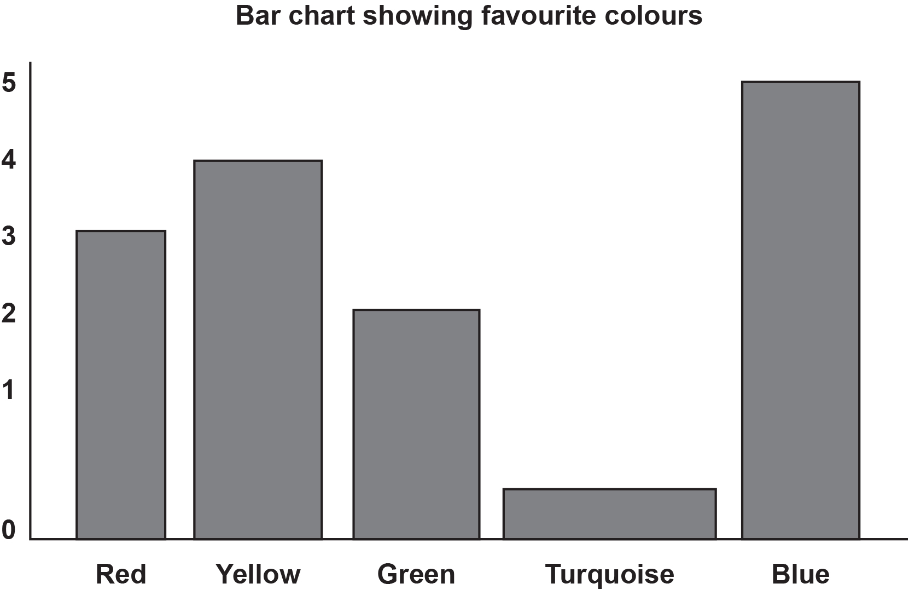
What’s wrong?
EXPLORE
Notes:
This bar chart has been drawn incorrectly. Ask learners examine that chart for a minute or so and identify things that are wrong with it.
Ask different learners for their feedback and discuss it.
If not mentioned, highlight the following:
Neither axis has a title
The y-axis has unequal intervals
The width of the bars on unequal
The title is incomplete (who’s favourite colours?).

Slide 5

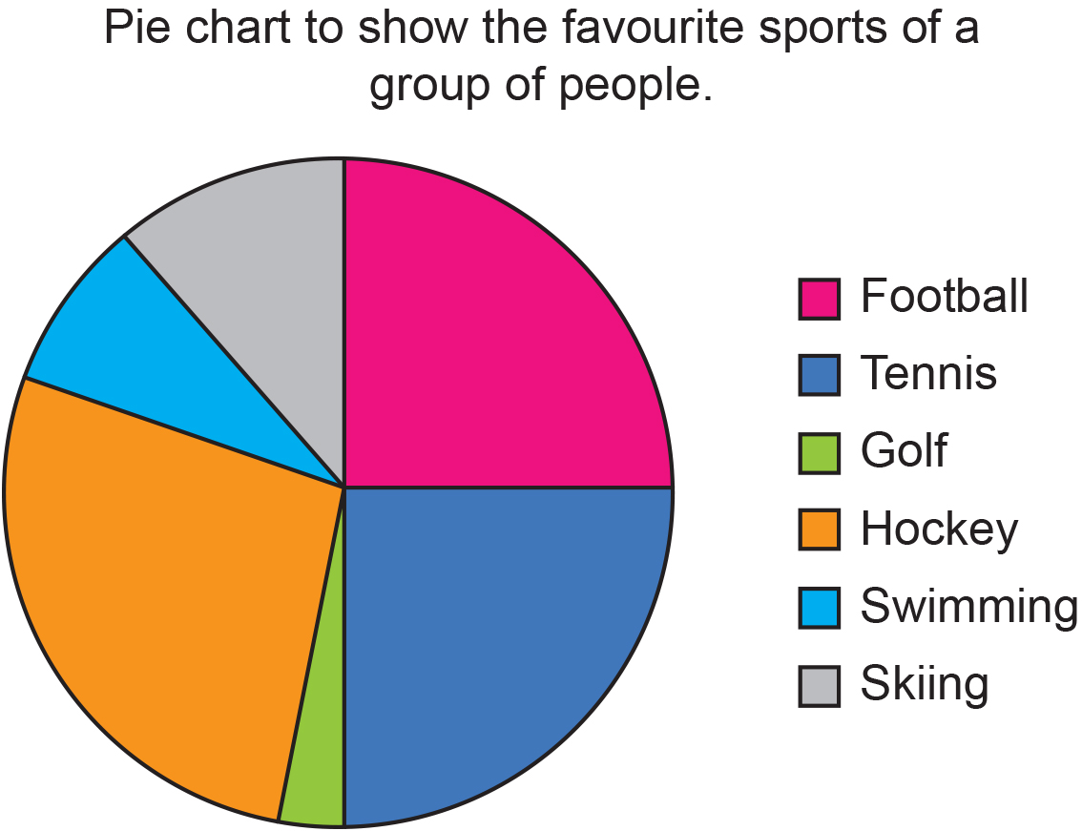
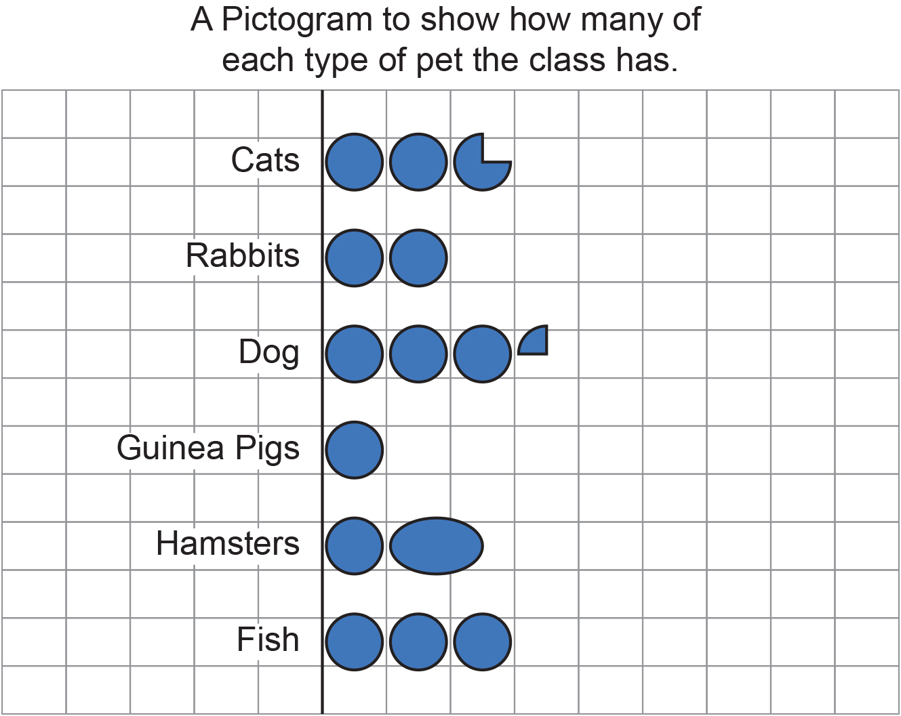
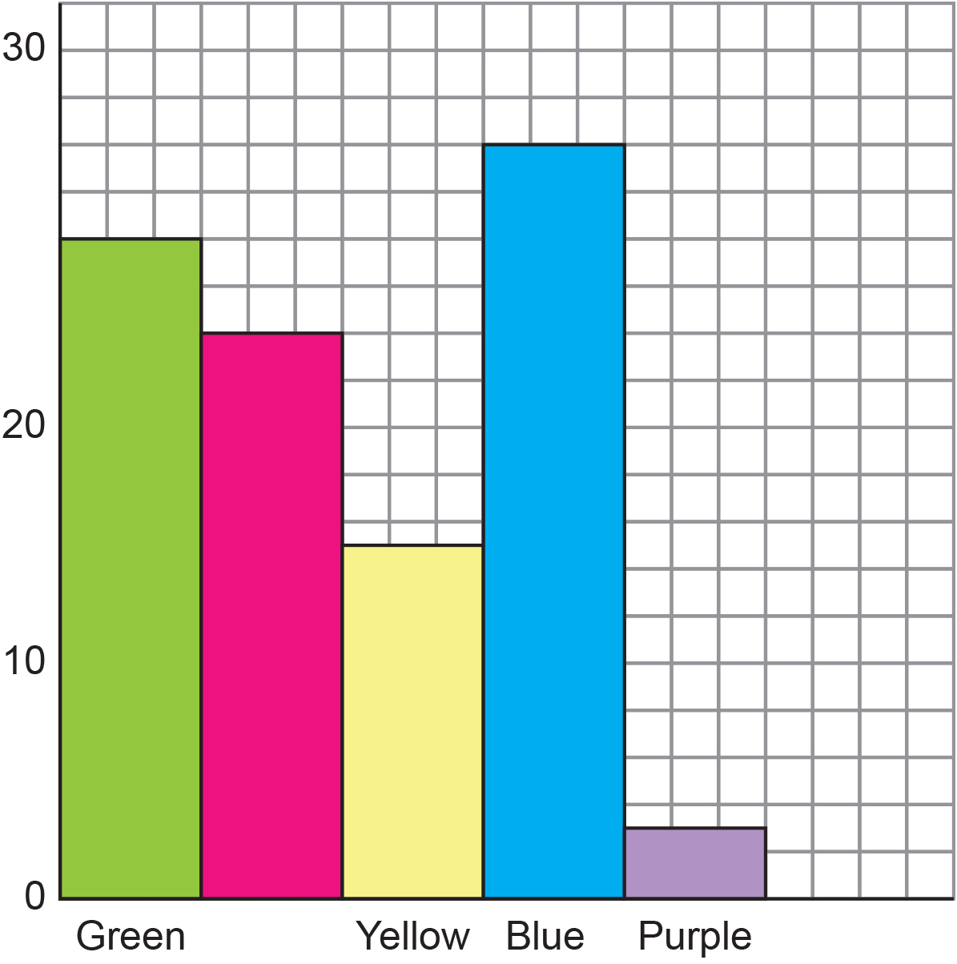
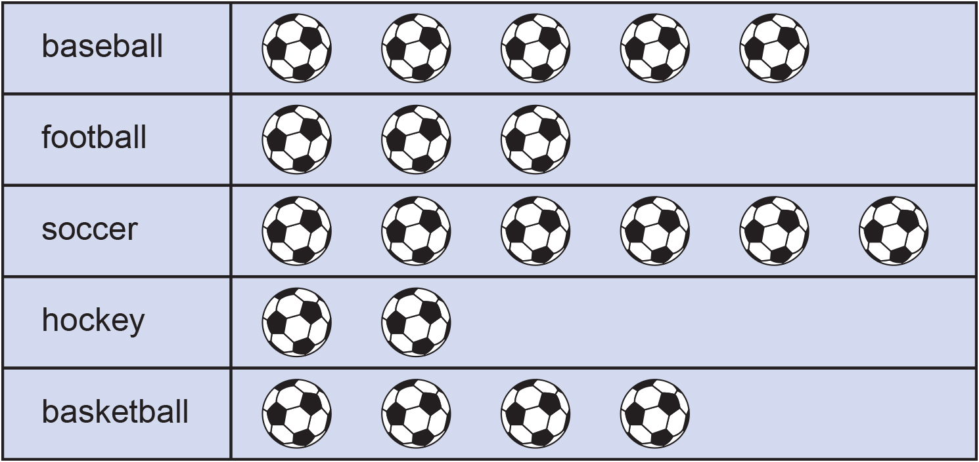
What’s wrong?
YOUR
TURN
Handout
available
Look at the charts you’ve been given. Each has been drawn with mistakes or bits of information missing.
Work in pairs to identify what’s wrong with each chart.
Notes:
Ask learners to work in pairs and give each pair a ‘What’s wrong?’ handout. Explain that each chart has been drawn with mistakes and information missing, and that their task is to identify the mistakes and note them on the handout.
All learners 5-7 min to complete the task, then take feedback about each chart.
Highlight the need to check charts that learners have plotted to ensure that they have not made similar mistakes.

Slide 6

Representing data
YOUR
TURN
KEY IDEA
Graphs and charts need to be labelled and plotted accurately to be understood by the reader.
Labels may include:
a title (say what the chart is showing)
axis titles
evenly spaced divisions and labels on axes
a key
Notes:
Emphasise that the purpose of graphs and charts is to communicate complex information clearly to the reader. To do this, they need to be labelled and plotted accurately.
Highlight that all graphs and charts should have a title, but that other labels depend on the type of chart. (Axes titles and labels are required on a bar chart, whereas a key is required on a pictogram, and often a pie chart).
Answers
Graph 1
No title
No key
Graph 2
No key
Some circles are ovals
Some data inconsistent between the pictogram and frequency table
Graph 3
No title
Label missing on bar
The y-axis has unequal intervals
Graph 4
Data missing
One section is slightly wider than the rest (*copyeditor am I missing anything else here?)

Slide 7
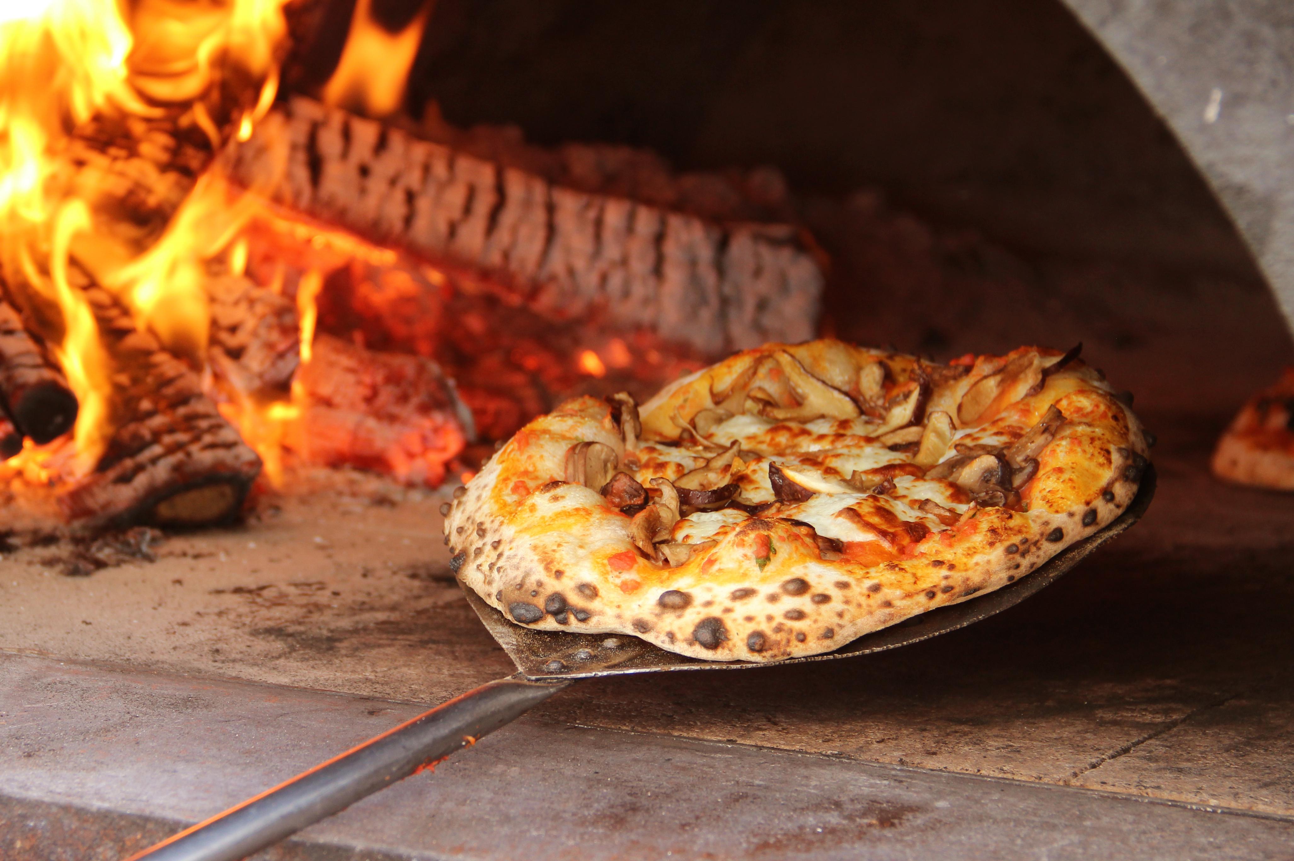
Festivals: food stall
Dan has a stall selling food at festivals.
To help him plan what to sell, Dan is analysing his sales figures.
Notes:
Introduce the context to the next section, which focuses on understanding and interpreting data shown on charts.

Slide 8
What does Dan learn from this bar chart?
EXPLORE
What is the most popular food sold?
How many more fries were sold than pizzas?
Which items did Dan sell more than 30 of?
What might Dan decide to do on the basis of this chart?
Notes:
Ask learners to think individually about the chart and write down two things that they know from it. Allow about 1 min for this before taking some brief feedback.
Extend this by clicking to reveal the questions one by one. Learners could be asked to display their answers on min-whiteboards, or you could nominate different learners to answer. Make sure you ask learners to explain their reasoning each time.
Finish by asking learners what they think were the more challenging questions.
Answers:

Slide 9
Festivals: writing questions
DISCUSS
Handout
available
In pairs or small groups, discuss the chart you’ve been given and what it tells you.
Underneath the chart, write down three questions that can be answered using the chart – one should be easy, and the other two more difficult.
Pass your chart and questions on to another group of students (preferably one who have worked on a different chart).
After you have answered the questions given to you, pass your work back to the group who set them for marking.
Notes:
Ask learners to work in pairs or small groups and give each pair a copy of one of the ‘Writing questions’ charts (try to ensure there are equal numbers of groups with the 3 different charts).
First of all, ask the pairs/groups to examine the chart and check that they understand it, then discuss what questions could be asked about the chart and agree three that they like best (ideally this should include one easy and two more difficult questions). Learners should write these down underneath the chart.
Next, ask learners to pass their questions to another group to answer. Try to ensure that questions are passed to a group which has been looking at a different chart. The recipients should then discuss the questions and write in their answers next to the questions.
Finally, groups should return their answers to the group who set the questions, who should mark them and give feedback to those who answered them.
Finish by asking what questions were the most interesting and what questions were the most difficult.
What is the most popular food sold? Burgers
How many more fries were sold than pizzas? 25
Which items did Dan sell more than 30 of? Burgers, pizza, fries, canned drinks

Slide 10
Interpreting pie
DISCUSS
Charts
Kate collects data on favourite brands of sports clothing
She asks 240 people.
How can you work out how many chose each brand?
Explain your method to your partner.
Think of three more questions to ask your partner.
AirStrike
72°
Notes:
Introduce the context for this graph – Kate is collecting data on favourite brands of sports clothing (why might she want to know about this?) and asks 240 people. Highlight that the size of the sectors of the pie chart show the angles for each brand, but not the actual numbers who chose that brand.
Ask learners to discuss in pairs how they could find the numbers (or frequency) of people choosing each brand from the angles shown (allow 2-3 min to discuss).
Take feedback and ask learners to model their different approaches used by the group. Discuss any errors or misconceptions that arise along the way.
Summarise by saying that the number of degrees around the pie chart must always be 360. So the task is one of converting degrees to frequencies. Make the link with proportion problems covered earlier in the scheme of work (e.g. scaling up recipes or converting between units & currencies). Remind learners about what approaches may have helped then (e.g. ratio tables and double number lines)

Slide 11
Using a ratio table
DISCUSS
÷ 10
÷ 2
x 2
Degrees | 360
People | 240
180
36
72
120
24
48
÷ 2
x 2
÷ 10
Notes:
This slide shows how a ratio table can be used to solve the previous question. If this hasn’t already been addressed, use can use the animated sequence to model this approach – although it might be better to draw the ratio table on the whiteboard and get the learners to suggest what values they would include.

Slide 12







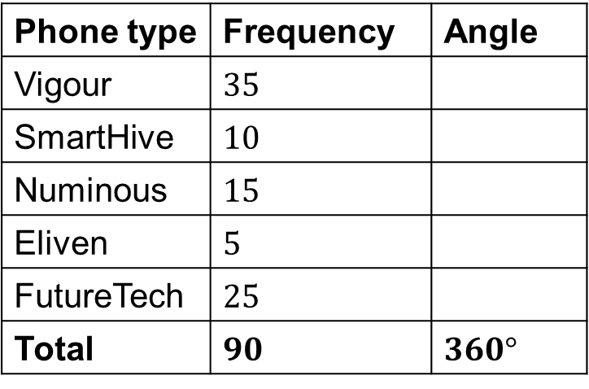

DISCUSS
Constructing a pie chart
In a survey, people were asked which model of phone they preferred.
The information is given in the table.
Display the information in a pie chart.
Phone type | Frequency | Angle
Vigour | $35$
SmartHive | $10$
Numinous | $15$
Eliven | $5$
FutureTech | $25$
Total | $90$ | $360°$
$$140°$$
$$40°$$
?
$$60°$$
$$×4$$
$$20°$$
$$100°$$
Check they add up to make $360°$!
?
$$×4$$
Notes:
Reveal the question and ask learners what they need to do to plot a pie chart (i.e. work out the angles)
Next reveal the table and ask learners what is the same and what is different about this problem compared to the previous one (i.e. it is still converting between degrees and frequency – but in the reverse direction – so it is still a question of using proportion to scale up – or down).
Allow 30 sec or so thinking time, then ask learners how they would go about this problem. Probe, as required, to bring out that 90 needs to be multiplied by 4 to give 360 (show animation), and so all the individual frequencies also need to be scaled up by a factor of 4. Note that what is shown can also be seen as a ratio table – and that the calculation could be done in 2 steps (x2 and x2).
Ask the group to complete the table, row by row, using the animation to confirm answers.
Remind learners at the end that the angles should dd up to 360 – they need to check!

Slide 13
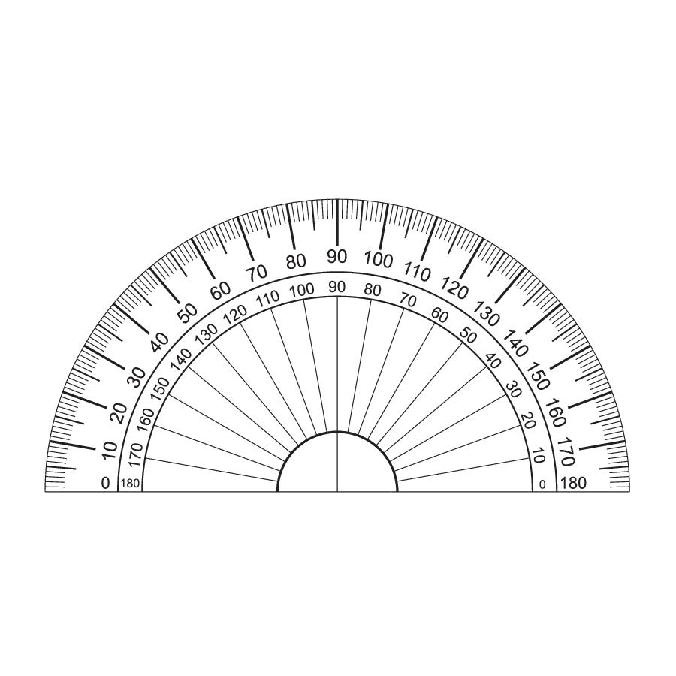




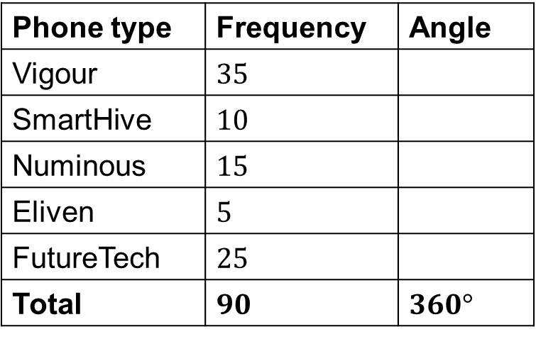


DISCUSS
Constructing pie charts
Phone type | Frequency | Angle
Vigour | $35$
SmartHive | $10$
Numinous | $15$
Eliven | $5$
FutureTech | $25$
Total | $90$ | $360°$
$$140°$$
$$40°$$
$$60°$$
Vigour
$$20°$$
$$100°$$
?
$$×4$$
Notes:
Use slides 13 to 15, as required, to model the plotting of the pie chart using a protractor.

Slide 14




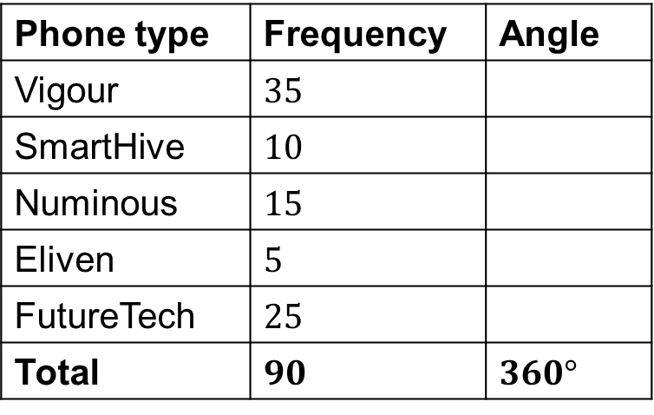


DISCUSS
Constructing a pie chart
Phone type | Frequency | Angle
Vigour | $35$
SmartHive | $10$
Numinous | $15$
Eliven | $5$
FutureTech | $25$
Total | $90$ | $360°$
$$140°$$
$$40°$$
$$60°$$
Vigour
$$20°$$
$$100°$$
SmartHive
?
$$×4$$
Notes:
Use slides 13 to 15, as required, to model the plotting of the pie chart using a protractor.

Slide 15

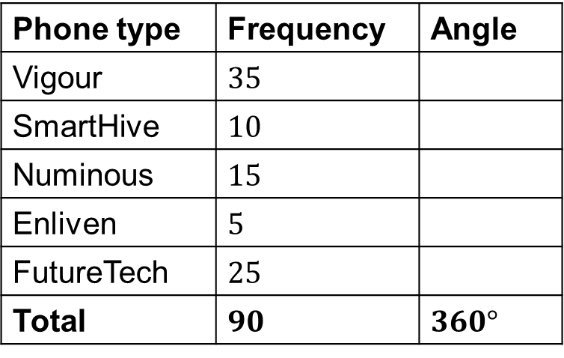





DISCUSS
Constructing a pie chart
Phone type | Frequency | Angle
Vigour | $35$
SmartHive | $10$
Numinous | $15$
Enliven | $5$
FutureTech | $25$
Total | $90$ | $360°$
$$140°$$
FutureTech
$$40°$$
Vigour
$$60°$$
$$20°$$
Enliven
$$100°$$
Numinous
SmartHive
?
$$×4$$
Notes:
Ask what would we do differently if we had asked 60 people, 30 people, 600 people…
Summarise by reminding learners that this is always a matter of scaling the number up or down to 360 (and how ratio tables or DNLs might help).

Slide 16
Working in pairs
YOUR
TURN
Handout
available
Take turns to place a card.
Explain your reasoning for the match to your partner.
Your partner must agree, disagree or ask for more explanation.
Complete any blank cards.
16
Notes:
Tell learners they will be working in pairs to match frequencies with pictures of pie charts.
Emphasise that they are expected to work collaboratively and draw attention to the points on the slide.

Slide 17
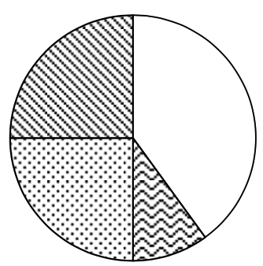
Matching frequency tables, angles and pie charts
YOUR
TURN
Handout
available
Phone type | Frequency
Vigour | 25
SmartHive | 40
Numinous | 15
Eliven | 20
TOTAL | 100
Phone type | Angle
Vigour | 180
SmartHive | 72
Numinous | 54
Eliven | 54
TOTAL | 360
17
Notes:
Provide each pair or small group of learners with a copy of the Frequencies, angles and pie charts grid, and a set of angles cards and pie chart cards.
Ask them to match the cards in rows across the grid, take turns and explain their reasoning to each other.
Note that there are two blank cards, which learners will need to fill-in to complete the grid.
Observe learners as they complete the task but try not to correct any mistakes at this stage. Instead, encourage students to explain their reasoning to each other and listen in to their explanations as you circulate.
ANSWERS
When learners have completed the activity, ask them to explain their thinking when matching the cards.
Did they need to move them around as they added further cards? Which ones did they find hardest to match and why?
After taking feedback, provide each pair with an answer sheet to check their work. Take questions and clarify any outstanding issues.
Angle table for Row D: Angles are 45, 45, 90, 180 and (TOTAL) 360 from top to bottom.
Pie chart for Row G: a pie chart with four equally distributed angles, each 90 degrees.

Slide 18
Constructing and interpreting pie charts
KEY IDEA
Constructing and interpreting pie charts involves direct proportion.
It requires conversions between frequencies and degrees (and vice-versa) by scaling up or down.
Ratio tables or double number lines may help with this.
Notes:
Emphasise the proportional relationship between frequency (no. of items) and degrees, and the connections with work that they did earlier in the year on proportion - including the use of ratio tables and DNLs.

Slide 19
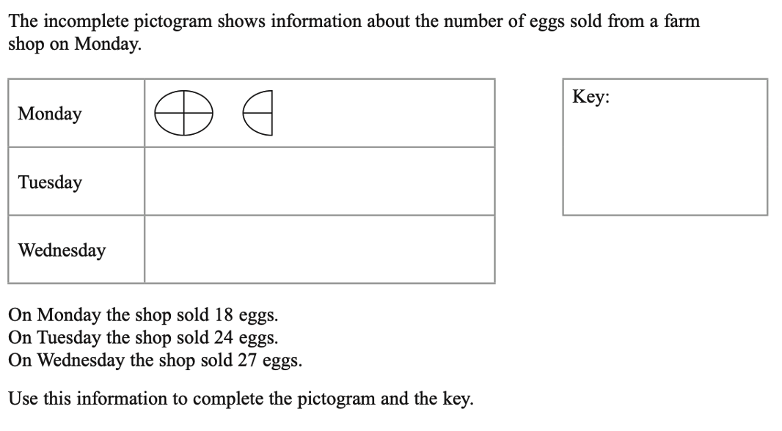
Practice question
REVIEW
Worksheet
available
The incomplete pictogram shows information about the number of eggs sold from a farm shop on Monday.
Monday
Tuesday
Wednesday
Key:
On Monday the shop sold 18 eggs.
On Tuesday the shop sold 24 eggs.
On Wednesday the shop sold 27 eggs.
Use this information to complete the pictogram and the key.
Notes:
12+ 12 =24
12+ 12+ 3= 27
Answers:
6 quarters stand for 18 eggs
1 quarter stands for 3 eggs
Key: 1 quarter = 3 eggs or 1 circle = 12 eggs
On Tuesday: 24 ÷ 3 = 8 quarters = 2 circles
One Wednesday: 27 ÷ 3 = 9 quarters = 2 circles and 1 quarter

Slide 20
Practice question- Answers
REVIEW
Worksheet
available
The incomplete pictogram shows information about the number of eggs sold from a farm shop on Monday.
Monday
Tuesday
Wednesday
Key:
represents 12 eggs
On Monday the shop sold 18 eggs.
On Tuesday the shop sold 24 eggs.
On Wednesday the shop sold 27 eggs.
Use this information to complete the pictogram and the key.
Notes:
12+ 12 =24
12+ 12+ 3= 27

Slide 21
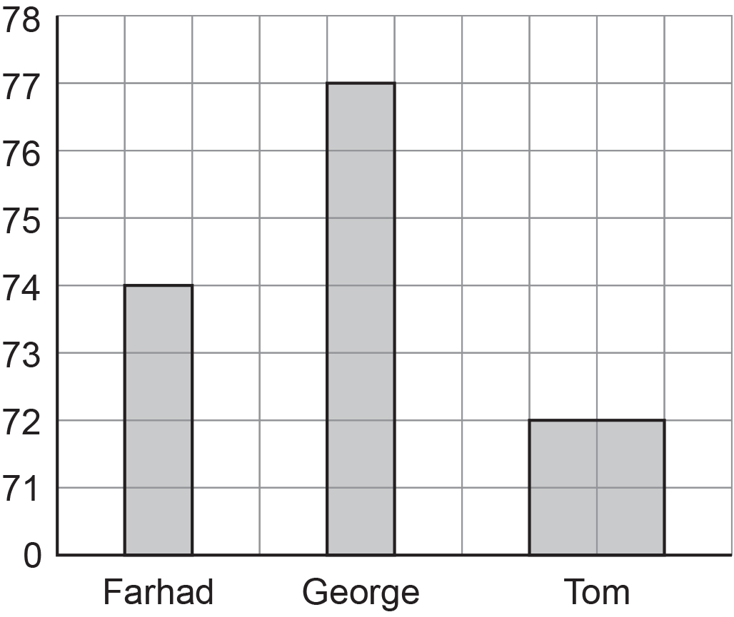
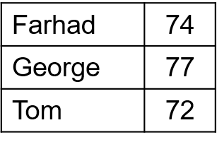
Practice question
REVIEW
Worksheet
available
Farhad, George and Tom each did a test.
Here are their marks for the test.
George drew this bar chart to show the marks they got.
The bar chart is not fully correct.
1. The width of the last bar (Tom) is wrong, it should be one column wide
2. The numbering of the y-axis
Write down two things that are wrong with George’s bar chart.
Notes:
The width of the last bar (Tom) is wrong, it should be one column wide
The numbering of the y-axis

Slide 22
REVIEW
Practice question
Worksheet
available
The table gives information about the number of goals scored by each of three teams.
Draw an accurate pie chart for this information.
Team | Number of goals
City | 50
Rovers | 45
United | 25
Notes:
Answer, Correct angles are City – 150, Rovers – 135,United - 75

Slide 23

REVIEW
Practice question- Answer
Worksheet
available
The table gives information about the number of goals scored by each of three teams.
Draw an accurate pie chart for this information
Team | Number of goals
City | 50
Rovers | 45
United | 25
Degrees
United
150 °
City
135 °
75 °
Total
120
360
?
$$×3$$
Notes:
Answer, Correct angles are City – 150, Rovers – 135,United - 75

Slide 24
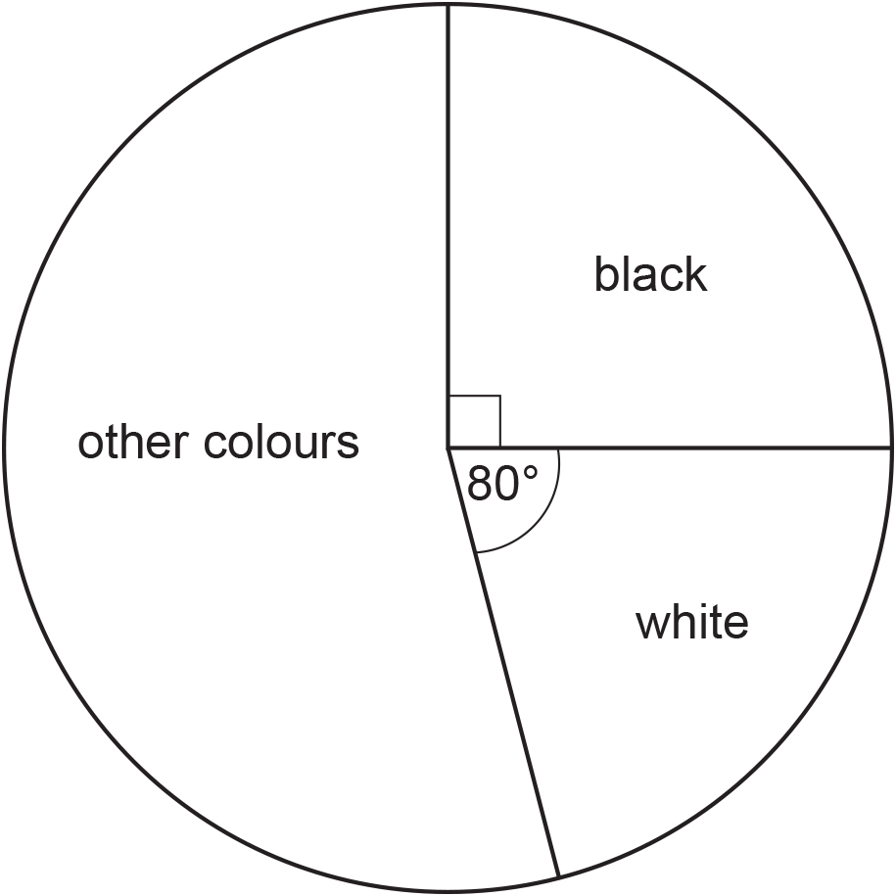
REVIEW
Practice question
Worksheet
available
The pie chart gives information about the colour of each car in a car park.
There are 135 black cars in the car park.
Work out the number of white cars in the car park.
Notes:
This is a more challenging question, which can be used as an extension.
Answer 120

Slide 25
REVIEW
Practice question
Worksheet
available
The pie chart gives information about the colour of each car in a car park.
There are 135 black cars in the car park.
Work out the number of white cars in the car park.
120

Slide 26
Lesson review:
43 Graphs and charts
Objectives
Read and interpret pictograms, bar charts and pie charts
Understand common errors when constructing graphs and charts
Construct pie charts.

Slide 27
Lesson 43:
Credits
Photos
123RF.com: attaphong Shutterstock.com: Anton Prohorov, Creation, Jojoo64, MyKwang'noii, Migren art, Stephen Marques, Bea Rue
Text Acknowledgements
Pearson Education Ltd: Pearson Edexcel ​GCSE (9-1) In Mathematics (1MA1) Foundation (Non-Calculator) November 2020 Paper 1F, Pearson Education Ltd: Pearson Edexcel ​GCSE (9-1) In Mathematics (1MA1) Foundation (Calculator) November 2020 Paper 2F, Pearson Education Ltd: Pearson Edexcel ​GCSE (9-1) In Mathematics (1MA1) Foundation (Calculator) November 2021 Paper 2F

