Slide 1
The role and purpose of financial reporting
ETF/Franklin Sixth Form College

Slide 2
Lesson 1
Monitoring business performance using profit and loss accounts

Slide 3
Introduction
Learning outcomes
Understand the role of profit and loss accounts in an organisation
Recognise the components of a profit and loss account
Complete basic profit and loss calculations using relevant formulae
Activity
Write one thing you know about profit and loss on a sticky note.

Slide 4
Profit and loss in an organisation
Discuss the purpose and role of profit and loss accounts in an organisation.
Feedback – whole-class discussion.

Slide 5
Key terms
Income statement | Definition
Sales revenue
Cost of sales
Gross profit
Other operating expenses
Operating profit
Interest and taxation
Exceptional items
Profit for the year (net profit)

Slide 6
Key terms: Answers
Income statement | Explanation
Sales revenue | Money coming in from sales Quantity sold x selling price
Cost of sales | Costs directly linked to the production of the goods or services sold (e.g. raw materials)
Gross profit | Sales revenue - cost of sales
Other operating expenses | All other costs associated with the trading of the business (e.g. salaries and marketing expenditure)
Operating profit | Gross profit - expenses
Interest | Amount charged for borrowing money
Tax | Money paid to government (percentage of profit made by the business)
Exceptional items | Any unusually large or infrequent transactions
Profit for the year (net profit) | Operating profit - interest and taxation

Slide 7
Task sheet 1: Financial key terms and data
Activity: Use the following words and numbers to complete the table on task sheet 1 (profit and loss blank-filling exercise).
  Gross profit
  £45,000
  Revenue
  Interest and taxation
  £85,000
  Expenses
  £33,750
  Profit for the year

Slide 8
Task sheet 2: Key financial data and terms
Activity: Use the information below to complete the key financial data table.
Sales revenue in year 1: £21.2 million
Sales revenue in year 2 was 10 per cent higher than in year 1
Cost of sales in year 1: 30 per cent of sales revenue
Cost of sales in year 2: 28 per cent of sales revenue
Expenses in year 1: £10.3 million
Operating profit in year 2: £11.1 million
Interest and taxation in year 1 and year 2: 20 per cent of operating profit

Slide 9
Key financial data and terms: Review
Feedback and discussion

Slide 10
What is the difference between profit and profitability?
Discuss

Slide 11
Profitability ratios
Profitability measures the financial performance of a business by comparing profits achieved to a second variable (e.g. revenue).
The three profitability ratios are:
  gross profit margin
  operating profit margin
  profit for the year (net profit) margin.

Slide 12
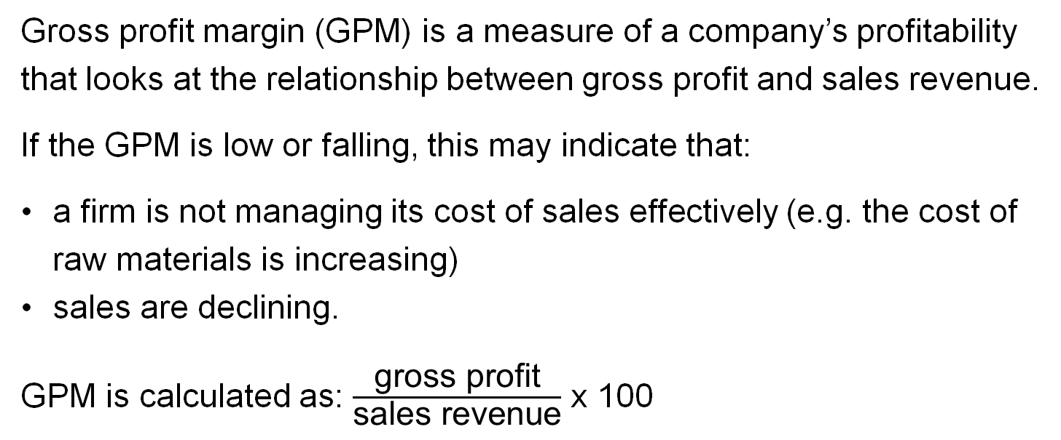
Gross profit margin
Gross profit margin (GPM) is a measure of a company’s profitability that looks at the relationship between gross profit and sales revenue.
If the GPM is low or falling, this may indicate that:
  a firm is not managing its cost of sales effectively (e.g. the cost of raw materials is increasing)
  sales are declining.
  GPM is calculated as: $\frac{\text{gross} \text{profit}}{\text{sales} \text{revenue}}$ x 100

Slide 13
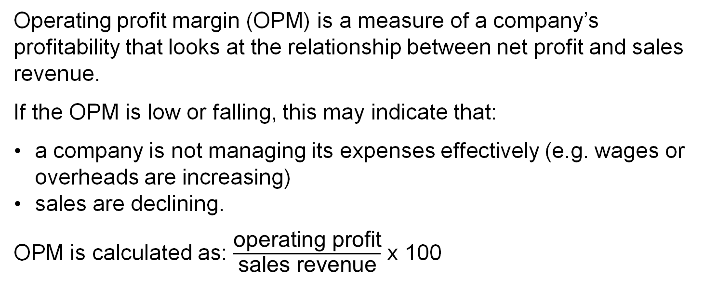
Operating profit margin
Operating profit margin (OPM) is a measure of a company’s profitability that looks at the relationship between net profit and sales revenue.
If the OPM is low or falling, this may indicate that:
  a company is not managing its expenses effectively (e.g. wages or overheads are increasing)
  sales are declining.
  OPM is calculated as: $\frac{\text{operating} \text{profit}}{\text{sales} \text{revenue}}$ x 100

Slide 14
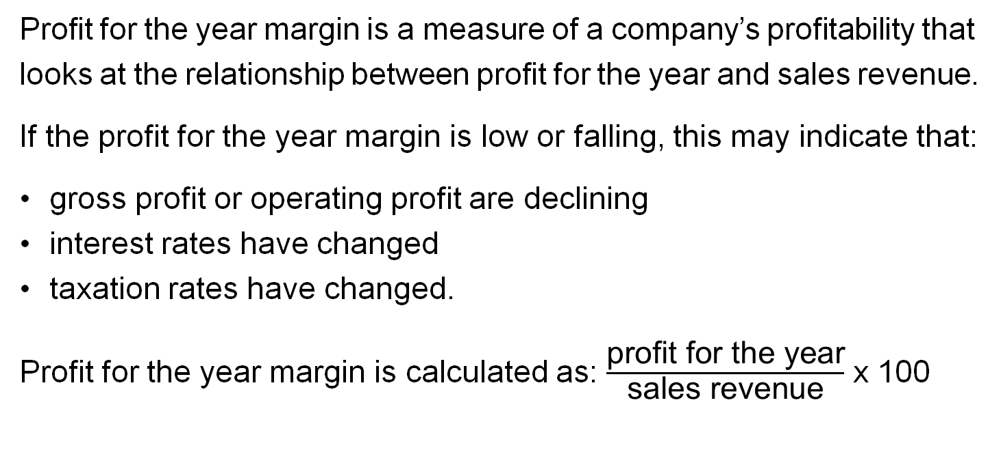
Profit for the year margin
Profit for the year margin is a measure of a company’s profitability that looks at the relationship between profit for the year and sales revenue.
If the profit for the year margin is low or falling, this may indicate that:
  gross profit or operating profit are declining
  interest rates have changed
  taxation rates have changed.
  Profit for the year margin is calculated as: $\frac{\text{profit} \text{for} \text{the} \text{year}}{\text{sales} \text{revenue}}$ x 100

Slide 15
Task sheet 3: Operating profit and operating profit margin
Activity: Complete task sheet 3, parts 1 and 2
Feedback

Slide 16
Break (10 minutes)

Slide 17
Task sheet 3 continued
Review parts 1 and 2
Complete parts 3, 4 and 5
Group discussion
What have we learnt so far?

Slide 18
Task sheet 4: Profit and loss calculations
Activity: Answer questions 1-6.

Slide 19
Task sheet 5: Trinity Retail case study
Activity: Use the information provided in the case study to complete the tasks shown below.
  Calculate the gross profit margin of Trinity Retail’s stores in 2023.
  Assess two actions taken by Trinity Retail to improve profitability.
  Be prepared to feed back and discuss.

Slide 20
Plenary
Activity:
Think back to the various components of a profit and loss account. Write down as many components as you can remember from the lesson.
Compare with the person sitting next to you.

Slide 21
Lesson 2
Developing business performance
using profit and loss accounts

Slide 22
Introduction
Learning outcomes
Compare and contrast a range of profit and loss accounts
Analyse financial data in a range of profit and loss accounts
Make recommendations for informed actions
Activity
In small groups, discuss the importance of profit and loss accounts in assessing business performance.

Slide 23
Task sheet 1: Case study – Sue’s Delights
Read the case study then complete the following tasks.
Assess the profitability of Sue’s Delights last year and this year.
What are your initial thoughts about the situation?
What further information would you need to help Sue’s Delights to improve its profitability?

Slide 24
Task sheet 1: Review and feedback
Circulate and consider the answers of others in the class.
Be prepared to feed back to the class.
Break (15 minutes)

Slide 25
Task sheet 2: Fresh – The Smoothie Company
Read the case study then complete the following tasks.
Calculate the net profit and gross profit margins of Fresh for 2021-22 and 2022-23.
Suggest two strategies that Fresh could implement to improve profitability.

Slide 26
Task sheet 2 continued
Produce a presentation to share with others outlining the two strategies you would use to improve profitability at Fresh.
Discuss the various strategies, including the likelihood of them being successful in improving profitability.

Slide 27
Task sheet 3: Scenarios
Work in small groups to look at the scenarios that can impact a company’s profit or loss (sales revenue, costs of goods sold, operating expenses, etc.).

Slide 28
Task sheet 3: Quick evaluation
Individually, note which of the scenarios has the biggest impact and which scenario has the smallest impact.
Prepare to share your thoughts with the class.

Slide 29
Plenary
Summarise the key concepts covered in the lesson, including:
    why organisations use profit and loss accounts
    technical terms (sales revenue, gross profit, net profit and expenses).
Evaluate your own understanding and reflect on your learning. Produce a quick graphic organiser setting out what you have learnt in this lesson.

Slide 30
Lesson 3
Monitoring business performance using cash flow to monitor income and expenditure

Slide 31
Introduction
Learning outcomes
Describe the role of cash flow and cash-flow forecasting in
an organisation
Explain how cash flow is used to monitor income and expenditure
Use a combination of profit and loss and cash flow to monitor business performance in relation to income and expenditure
Activity
Write one thing you know about cash flow on a sticky note.

Slide 32
Task sheet 1: Cash-flow forecasting
The purpose of putting together a cash-flow forecast is to monitor finances over a set period – usually a month, a quarter or a year.
Activity
Using the template in task sheet 1, put together your own cash-flow forecast for the next four weeks.

Slide 33
Key terms
Cash-flow forecast | Explanation
Inflows
Outflows
Net cash flow
Opening balance
Closing balance

Slide 34
Key terms: Answers
Cash-flow forecast | Explanation
Inflows | Income: Money received from sales, investments, loans, rents, etc.
Outflows | Expenditure: Money for expenses, debts, purchases, wages, etc.
Net cash flow | Total inflows - total outflows (positive net cash flow means more coming in than going out; negative means more going out than coming in)
Opening balance | The amount of money that a business starts with at the beginning of the period
Closing balance | The amount of money that a business has at the end of that period (opening balance + net cash flow)

Slide 35
Task sheet 2: Cash-flow matching exercise
Activity
Take the cards and sort them into the following groups:
  Outflows
  Inflows
  Key cash-flow terms

Slide 36
Task sheets 3a and 3b: Cash-flow activity
Activity
Use the information in the task to complete a cash-flow statement. You will be given a case study (task sheet 3a) and a template (task sheet 3b).
Break (for 10 mins)
Feed back to the rest of the group, offering potential advice based on the statement.

Slide 37
Task sheet 4: Cash flow for Fresh
In the previous lesson, we looked at a smoothie company called Fresh and its profit and loss account.
The company management now wants you to produce a cash flow for 2022 for them.
As with the previous task, you will be expected to share your findings and offer advice.

Slide 38
Comparing profit and loss and cash flow
In small groups, make some overall comments about the financial health of Fresh. Use both your profit and loss information and your cash-flow statement.
Assume you will be feeding this back to Fresh.
Identify some positives, negatives and areas for concern.
Conclude with some final recommendations.

Slide 39
Plenary
What have we learnt today?
Record your progress.

Slide 40
Lesson 4
Monitoring business performance using a balance sheet

Slide 41
Introduction
Learning outcomes
Explain the role of a balance sheet in a business
Recognise the components of a balance sheet
Complete basic liquidity ratios using balance-sheet information
Activity
Write one thing you know about balance sheets on a sticky note.

Slide 42
The importance of producing and monitoring balance sheets for business performance
A balance sheet gives a snapshot of a company’s financial position.
It details what a business owns (assets) and what it owes (liabilities), and it can be used to calculate a business’s net worth.
The following slide gives some of the key terms on a balance sheet.
Try to define them.
We will then discuss the correct definitions.

Slide 43
Key terms (1)
Key term | Definition
Non-current/fixed assets
Current assets
Current liabilities
Non-current/long-term liabilities
Net assets
Share issue
Retained profit

Slide 44
Key terms (2)
Key term | Definition
Non-current/fixed assets | Items owned by the business that it will continue to own for more than one year, e.g. building and machinery
Current assets | Cash or an item that is expected to be converted into cash within one year
Current liabilities | Money the business owes which it will pay back within one year, e.g. overdraft
Non-current/long-term liabilities | Money the business owes which it will pay back in over one year, e.g. bank loan
Net assets | The company’s assets after all liabilities have been taken away
Share issue | Money raised from the sale of shares
Retained profit | Profit from previous year kept by the business

Slide 45
Task sheet 1: Card sorting activity
Activity
Sort the cards into the following categories:
Current assets
Fixed assets
Current liabilities
Long-term liabilities

Slide 46
Balance-sheet net worth task
Businesses use balance sheets to:
show their net worth (how much the company is worth after all the liabilities have been accounted for)
demonstrate where the company’s money has come from.
Parts A and B must end on the same figure – hence the term ‘balance sheet’, as we will see on the next slide.

Slide 47
Task sheet 2: Balance-sheet template
PART A | £ | £
Fixed assets
Vehicles
Land
Machinery
Current assets
Stock
Debtors
Bank/cash
Current liabilities
Creditors
Dividends due
Working capital (CA-CL)
Long-term liabilities
Bank loans
Net assets (TA-TL)
PART B
Financed by
Capital
Retained profit

Slide 48
Task sheet 3: Balance-sheet activity
During the previous lesson we looked at a smoothie company called Fresh – its profit and loss account and its cash flow.
The management want you to produce a balance sheet for 2023.
They have provided you with the layout and figures.

Slide 49
Task sheet 3: Answers
 | £
Fixed assets
Vehicles | 40,000
Machinery | 5,000
Factory | 50,000 | 95,000
Current assets
Cash | 22,000
Debtors | 2,500
Inventory/stock | 2,500 | 27,000
Current liabilities
Overdraft | 3,750
Creditors | 1,500 | 5,250
Long-term liabilities
Bank loan | 40,000
Mortgage | 50,000
 |  | 90,000
Net assets (total assets - total labilities) |  | 26,750
Equity
Shares issued | 10,000
Retained profit | 16,750
Total equity |  | 26,750

Slide 50
Analysing the balance sheet
Businesses can use a balance sheet to monitor their ability to service short-term debts.
There are two ratios that a company can use to analyse the balance sheet: current ratio and acid test ratio.
These are both liquidity ratios.

Slide 51
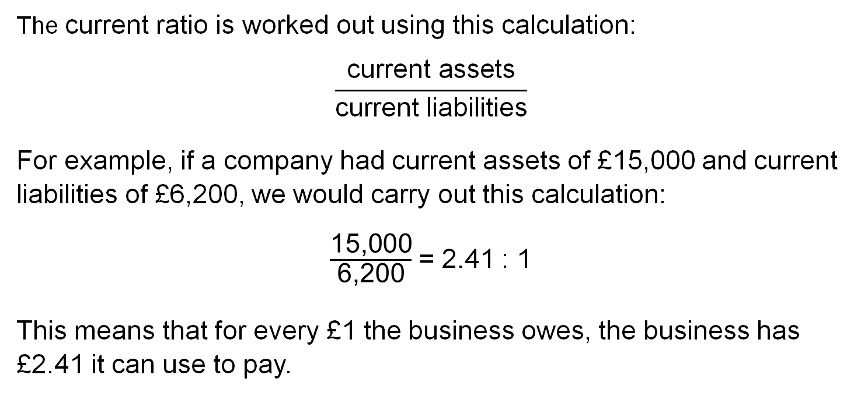
Ratios explained: Current ratio
The current ratio is worked out using this calculation:
$$\frac{\text{current} \text{assets}}{\text{current} \text{liabilities}}$$
For example, if a company had current assets of £15,000 and current liabilities of £6,200, we would carry out this calculation:
$\frac{\text{15,000}}{\text{6,200}}$ = 2.41 : 1
This means that for every £1 the business owes, the business has £2.41 it can use to pay.

Slide 52
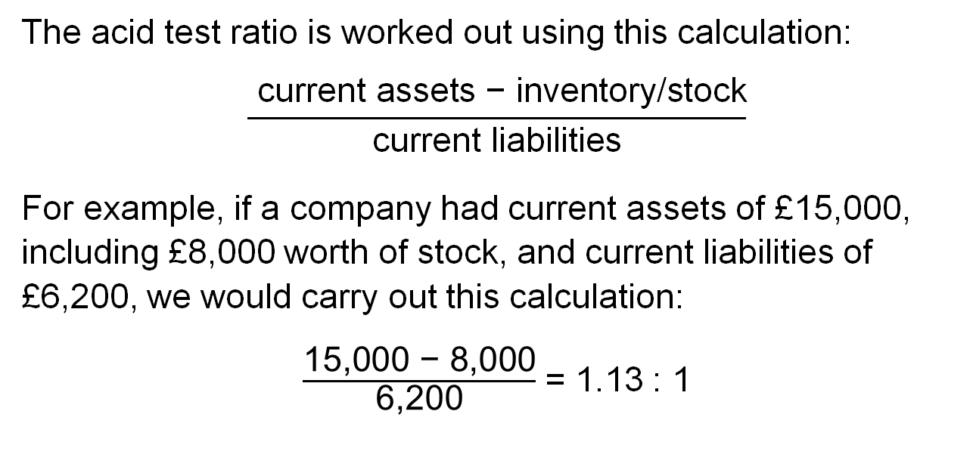
Ratios explained: Acid test ratio
The acid test ratio is worked out using this calculation:
$$\frac{ \text{current} \text{assets}\text{ − }\text{inventory}\text{/}\text{stock}}{\text{current} \text{liabilities}}$$
For example, if a company had current assets of £15,000, including £8,000 worth of stock, and current liabilities of £6,200, we would carry out this calculation:
$\frac{\text{15,000 − 8,000}}{\text{6,200}}$ = 1.13 : 1

Slide 53
Liquidity ratios: Can you interpret them?
Using the figures from the previous slide for acid test, explain what it would mean for the business.
Now calculate the current ratio and acid test ratio for Fresh and compare them to the figures from our example.
In each case, which business has better liquidity? Why?

Slide 54
Balance-sheet case study
Maureen’s is a coffee shop chain in Yorkshire with 12 shops. Maureen is trying to work out the liquidity of her business but needs some help.
 | 2022 | 2023
Stock | 25,000 | 20,000
Debtors | 23,000 | 16,000
Cash | 7,200 | 8,400
Current liabilities | 45,000 | 40,000

Slide 55
Maureen’s Coffee Shop: Questions
What does ‘liquidity’ mean?
Calculate the current ratio and acid test ratio. Show your working.
Do you think Maureen should be worried? Why (not)?

Slide 56
Monitoring the balance sheet
Monitoring a balance sheet over time can highlight important trends that could be an issue for the business.
Give four examples of changes in a balance sheet that might occur over time and what they could mean for the business.

Slide 57
Plenary
Businesses calculate current ratio and acid test ratio to measure liquidity.
Give a quick overview of each measure and explain why businesses carry them out.

Slide 58
Lesson 5
Developing business performance using the balance sheet

Slide 59
Introduction
Learning outcomes
Compare and contrast a range of balance-sheet entries
Identify issues with balance-sheet records
Analyse balance-sheet data
Make recommendations for informed actions
Activity
Write one thing you can remember about balance sheets on
a sticky note.

Slide 60
The importance of producing and monitoring balance sheets for stakeholders
Stakeholders often review a company’s balance sheet.
Consider each of these stakeholder groups and what their interest in a balance sheet may be.
Stakeholder group | Interest
Shareholders
Employees
Suppliers
Customer
Government
Creditors

Slide 61
Task sheet 1: Ecomart balance sheet
Activity
Work in small groups to answer the questions on task sheet 1.
You will have 30 minutes.
Be prepared to share your feedback with the rest of the class.

Slide 62
Pros and cons of balance sheets
As with all financial statements, a balance sheet has limitations.
With a partner or in a small group, spend 15 minutes identifying the possible benefits and limitations of creating a balance sheet.

Slide 63
Possible responses
Benefits | Limitations
Allows stakeholders to see financial health. | It is only a snapshot, so it is only representative of a specific date and time.
Can be used to assess the liquidity of a business. | Values reported are often based on accounting assumptions or forecasted figures.
Can be used to calculate the net worth of a business. | Limited information, so it needs to be analysed alongside other financial documents.

Slide 64
Ecomart balance-sheet review
Now that we have identified the benefits and limitations of a balance sheet, we will revisit Ecomart.
Apart from cash flow and profit and loss accounts, what else would you like to know about Ecomart before advising its management and making recommendations about the future?
You will have 20 minutes.

Slide 65
Task sheet 2: Balance sheets at Tesco
The balance sheets we have seen so far have been put together to help you to learn.
Via the link below, you can find all the financial statements for Tesco, including the balance sheet. https://www.tescoplc.com/investors/reports-results-and-presentations/financial-performance/group-balance-sheet
Open the link and answer the questions on task sheet 2.

Slide 66
Feedback on Tesco
Produce a document or a set of slides using information from Tesco.
Compare 2022 with 2023.
Is the financial performance in one year better than the other?
Has Tesco’s financial value grown over the year?

Slide 67
Plenary
Spend five minutes producing a mind map with a partner summarising what you have learnt in this lesson.
Include:
key terms
how to use a balance sheet
limitations.

Slide 68
Lesson 6
Developing business performance using the concept and calculation of breakeven

Slide 69
Introduction
Learning outcomes
Understand the concept and calculation of breakeven in financial planning
Calculate the breakeven point using formulae or graphs
Analyse benefits and limitations of breakeven

Slide 70
Introduction to breakeven
Breakeven analysis is a tool used by businesses in financial planning.
It allows a business to establish the point at which total costs and total revenues are equal.
It is the point at which the business neither makes a profit nor a loss.
It informs a business about the number of sales it needs to make over a given period to reach this point.

Slide 71
Breakeven key terms
Break even | Definition
Breakeven point
Fixed costs
Variable cost per unit
Selling price
Contribution
Output/units
Margin of safety
Total costs
Revenue

Slide 72
Breakeven key terms
Break even | Definition
Breakeven point | The point at which total sales equals total costs
Fixed costs | Costs that remain the same regardless of sales or output
Variable cost per unit | Costs that vary directly with output
Selling price | The price at which a unit is sold
Contribution | The difference between selling price and variable cost per unit
Output/units | Number of items made
Margin of safety | Difference between sales and breakeven point
Total costs | Total variable costs and fixed costs
Revenue | Total amount of money received from the sale of goods or services
Education and Training Foundation

Slide 73
Identifying fixed and variable costs
You run a small pizza restaurant and delivery service called Mozzarella. Decide whether the following would be categorised as fixed or variable costs:
Rent for premises Cheese
Pizza bases Cleaning products
Tomatoes Heating and lighting
Wages for staff Manager’s salary
Advertising leaflets Insurance
Fuel for delivery van Road tax
Pizza boxes Pineapple

Slide 74
Constructing breakeven charts
We will now look at how to use figures to produce a breakeven chart for Mozzarella.
We have assumed that:
fixed costs per month = £5,500
variable cost per pizza = £4
selling price per pizza = £12.

Slide 75
Figure breakdown
Outputs/units | Fixed costs | Variable costs | Selling price | Total costs | Profit/ loss
0 | 5,500 | 0 | 0 | 5,500 | -5,500
50 | 5,500 | 200 | 600 | 5,700 | -5,100
100 | 5,500 | 400 | 1,200 | 5,900 | -4,700
150 | 5,500 | 600 | 1,800 | 6,100 | -4,300
200 | 5,500 | 800 | 2,400 | 6,300 | -3,900
250 | 5,500 | 1,000 | 3,000 | 6,500 | -3,500
300 | 5,500 | 1,200 | 3,600 | 6,700 | -3,100
350 | 5,500 | 1,400 | 4,200 | 6,900 | -2,700
400 | 5,500 | 1,600 | 4,800 | 7,100 | -2,300
450 | 5,500 | 1,800 | 5,400 | 7,300 | -1,900
500 | 5,500 | 2,000 | 6,000 | 7,500 | -1,500
550 | 5,500 | 2,200 | 6,600 | 7,700 | -1,100
600 | 5,500 | 2,400 | 7,200 | 7,900 | -700
650 | 5,500 | 2,600 | 7,800 | 8,100 | -300
700 | 5,500 | 2,800 | 8,400 | 8,300 | 100
750 | 5,500 | 3,000 | 9,000 | 8,500 | 500
800 | 5,500 | 3,200 | 9,600 | 8,700 | 900
850 | 5,500 | 3,400 | 10,200 | 8,900 | 1,300
900 | 5,500 | 3,600 | 10,800 | 9,100 | 1,700
950 | 5,500 | 3,800 | 11,400 | 9,300 | 2,100
1000 | 5,500 | 4,000 | 12,000 | 9,500 | 2,500

Slide 76
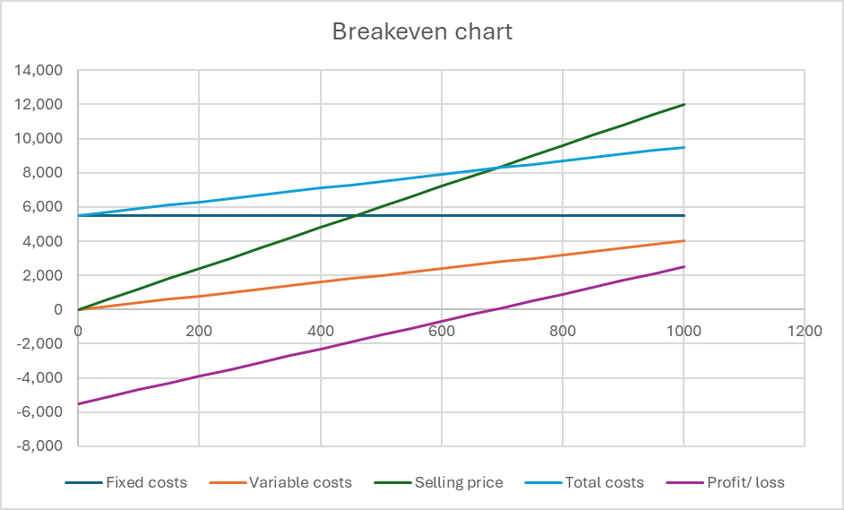
Breakeven point

Slide 77
Impact of changes to the breakeven point
Some costs have changed:
Fixed costs have gone up by £450 a month.
Variable costs have increased by 50p per pizza.
As a result, you increase the selling price per pizza to £13.
Create a new table with the new figures.
Using the graph paper provided, or working from a spreadsheet, create a new breakeven chart and identify the breakeven point.

Slide 78
Breakeven formula
Breakeven can also be calculated using a formula: fixed costs divided by contribution.
Check earlier notes to remind yourself of the definition of and formula for contribution.

Slide 79
Breakeven at Mozzarella using the calculation
Using the original and revised figures for Mozzarella, calculate the breakeven point for both situations using the formula.

Slide 80
Margin of safety
Margin of safety is the difference between the breakeven point and the total number of units sold.
Mozzarella are planning to produce and sell 800 pizzas a month.
Calculate the margin of safety using both previous examples of breakeven.
Identify it on your breakeven chart.

Slide 81
Breakeven formula practice
Let us check your understanding of the use of the calculation.
Using the task sheet 1 complete the calculations
Be prepared to share your answers.

Slide 82
Benefits and limitations
Below are some of the benefits and limitations of breakeven. Explain for each one why it is a benefit or limitation.
Benefits | Limitations
Margin of safety can be highlighted | Assumes the fixed costs stay the same
Tells you the point at which revenue covers costs | Assumes that all output will be sold
Allows you to conduct ‘What if?’ analyses | Must be calculated for every product line the business sells

Slide 83
Plenary and homework
Produce a quick summary of what you have learnt so far in this lesson.
Answers questions as directed.
Revise for next lesson, when you will complete a formative assessment task drawing on everything you have learnt over the last six lessons. This will help you to practise the skills needed to complete the Employer-set project.

Slide 84
Lesson 7
Managing financial health: A case study of an organisation

Slide 85
Introduction
Learning outcomes
Analyse and agree a proposal for the issue identified in the case study
Work collaboratively in groups
Recommend informed actions using an oral presentation

Slide 86
Managing financial health
Bucket List Cleethorpes is considering how to improve its revenue stream. It is also considering opening an additional office in a nearby location.
Evaluate the range of evidence and financial information to provide a justified recommendation as to whether or not to proceed and open the new office.

Slide 87
The formative assessment task
The following slides will provide guidance on each step of the formative assessment task.
You will be given a set time to complete each step.
After each step, we will come back as a whole group to get the instructions for the next step.
Please add your research and financial analysis to your presentation as you go so that you will be ready to present back at the end.
Each presentation should be three minutes.

Slide 88
Step 1: Review the case study and conduct some initial research into the industry (20 minutes)
Strengths | Weaknesses
Opportunities | Threats

Slide 89
Financial analysis
Step 2: Using extract 1, calculate the breakeven point, produce a breakeven chart, calculate expected average revenue based on the breakeven point and estimate when they are likely to break even. (20 minutes)
Step 3: Using extract 2, produce a monthly cash-flow forecast. (30 minutes)
Step 4: Using extract 3, produce a projected profit and loss for year 1. (30 minutes)
Step 5: Using extract 4, produce a projected balance sheet for the end of year 1. (30 minutes)

Slide 90
Presenting and plenary
In teams of three, you will present your findings to the rest of the group. Make a final, fully justified recommendation as to whether or not to go ahead with opening the new office.
Your presentation should last for three minutes.
Audience – please complete the presentation feedback form and prepare to ask one question.
Please note any areas of the course you need to revise.

Slide 91


ET-FOUNDATION.CO.UK
PRODUCED BY
FUNDED BY
Franklin Sixth Form College produced this resource on behalf of the Education and Training Foundation
This programme is funded by the Department for Education

