Slide 1


Lesson 5:
Scales, Maps and Units
Objectives
To be able to convert metric units of measurement
To be able to use a scale to find lengths
To be able to represent a proportional situation in a ratio table.

Slide 2

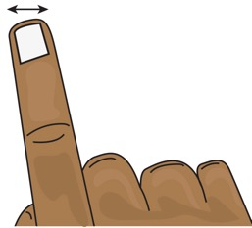
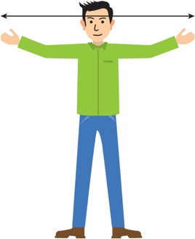
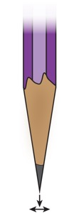
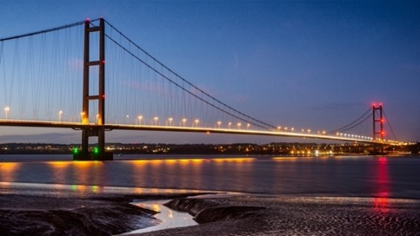
INTRODUCTION
Find the measurements
1 cm
10 mm
1 m
1 mm
1000 m
100 cm
1 km
Notes:
Learners to work in pairs to match the measurements and pictures.
Do they have a sense of how long each unit is?
When they complete the task, they should have all the metric conversions for length they will need in this lesson.
Answers:
Width of a finger: 1 cm
Arm span: 1 m
Pencil tip: 1 mm
Distance between two bridge pylons: 1 km

Slide 3
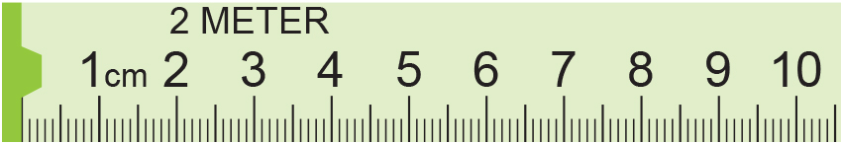
MODEL
Reading scales and converting metric units
3.9 cm
or 39 mm or 0.039 m
Convert this measurement to millimetres and to metres
Centimetres | 1
Millimetres | 10
0.039
Metres | 1
Centimetres | 100
x10
x10
3.9
÷100
÷100
39.0
3.9

Slide 4
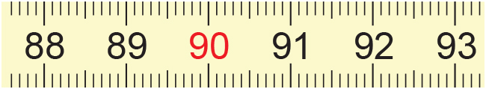
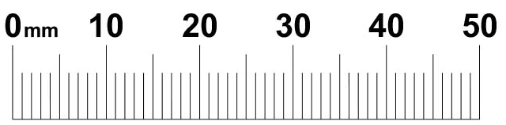
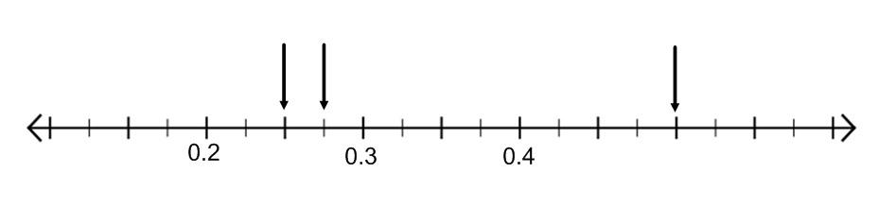
EXPLORE 1
Reading scales and converting metric units
1) Write these in cm, mm and m.
(a)
(b)
2) Write these in mm and cm.
(a)
(b)
(c)
(b)
(c)
(a)
3) Write these in m and cm.
m
Notes:
The worksheet has ratio tables pre-drawn to help students organise their thinking.
The scale in Q3 is harder to read. How can students help themselves to work this out?

Slide 5
REVIEW
Reading scales and converting metric units: answers
(a)
1) Write these in cm, mm and m.
89.3 cm, 893 mm, 0.893 m
91.0 cm, 910 mm, 0.91 m
(b)
2) Write these in mm and cm.
12 mm, 1.2 cm
24 mm, 2.4 cm
48 mm, 4.8 cm
(a)
(b)
(c)
3) Write these in m and cm.
(b)
(c)
(a)
0.5 m, 50 cm
0.25 m, 25 cm
0.275 m, 27.5 cm
m

Slide 6

EXPLORE 1
Rahima’s mistake
Rahima is doing a metric conversion.
Rahima is not correct?
Can you explain why with a ratio table?
‘0.3 m is the same as 0.003 cm because
you divide by 100 to change from m to cm.’
Notes:
Learners may give the answer that Rahima needs to multiply by 100 but can they explain why this is correct?
Diagrams such as ratio tables make this explanation very clear.

Slide 7
REVIEW
Rahima’s mistake: using ratio tables
cm
metres
100
10
30
1
0.1
0.3
So, 0.3 m is 30 cm.
Notes:
Using a ratio table to illustrate the conversion will allow learners to work well without a calculator and will underpin their understanding of converting between metric units.
Ask questions such as:
Would you use all of these steps?
What could you do differently?
This allows learners to really think about the relationship of the numbers with a simpler example before moving on to the more difficult tasks coming up.
A ratio table is used to illustrate approaches. It is important to reiterate that this used for illustration of a range of approaches. Although the ratio table is provided, it is only intended to be used to capture learners’ thinking, not as a ‘method’. The ratio table does, however, suggest multiplicative approaches and is encouraged to be used, along with their own diagrams, if appropriate, to capture your learners’ thinking. What is important is that the learners understand what they, and their peers, have done.

Slide 8
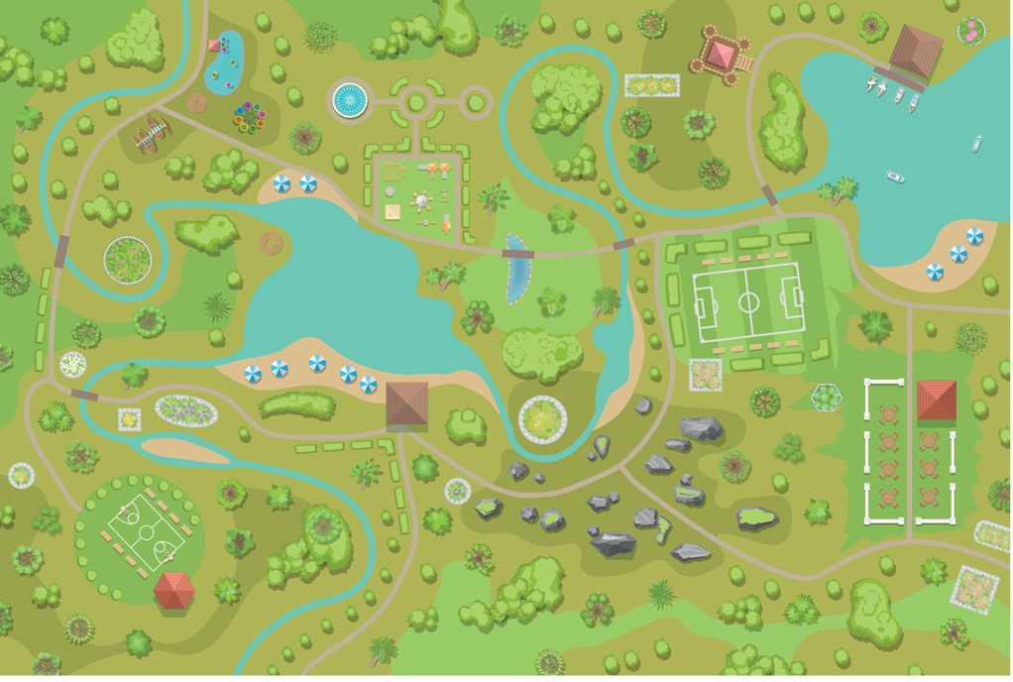

MODEL
Using a 1:n scale
2
A ranger based in the visitor centre in a local park receives a message that a dog has been sighted wandering without its owner on the football pitch. They suspect it is probably lost.
Can you find out how far away the dog is in a direct straight line in metres?
4
football pitch
5
3
visitor centre
575 metres
1
Scale 1:5000
m | 1
cm | 100 | 57 500
Map distance | 1
Real distance | 5000
575
11.5 cm
57 500 cm
Notes:
Here we look at the map scale 1:n.
This slide models how to measure the distances on the map then use ratio tables to calculate the real distance in the same unit and then convert it to a more sensible unit.
If you would like the students to measure this distance you can use the map on the first page of handout 4. This will image is at the right size. The measurement of 11.5 is from the middle of the visitors centre to the centre of the football pitch.

Slide 9

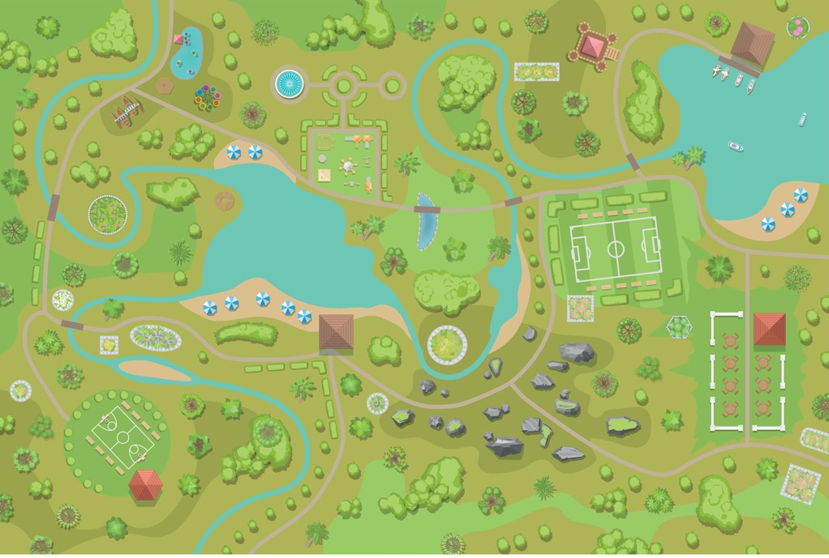
EXPLORE 4
Park ranger
2
The ranger must do a check of the facilities every afternoon.
They need to visit these places before returning to the visitor centre:
Boathouse
Garden café
Playground
Lakeside café
Which order should the Park Ranger visit them in?
How far will they have to travel between each place? What is their total journey distance?
4
5
3
1
Key
1 – Visitors centre
2 – Boathouse
3 – Garden cafe
4 – Playground
5 – Lakeside cafe
Notes:
You may want to remind learners to take into account the fact that they cannot move directly across bodies of water for example.

Slide 10
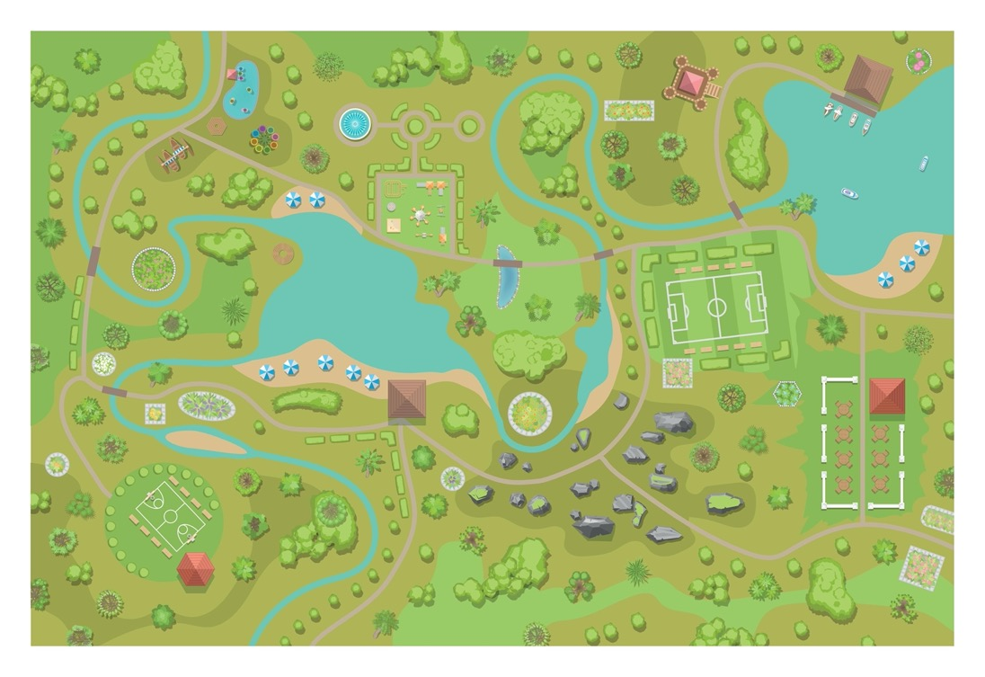
REVIEW
Park ranger
2
From | To | Map Distance (cm) | Real Distance (cm) | Real Distance (m)
4
5
3
1
Key
1 – Visitors centre
2 – Boathouse
3 – Garden cafe
4 – Playground
5 – Lakeside cafe
Total distance =
Notes:
Example answer:
The distances between the locations, avoiding obstacles, for one option are:
From visitors center (1) to lakeside café (5) – map distance (cm) 5.5cm, real distance 27,500 cm, 275 metres
From lakeside café (5) to garden café (3) – map distance (cm) 10 cm, real distance 50,000 cm, 500 metres
From garden café (3) to boathouse (2) – map distance (cm) 10 cm, real distance 50,000 cm, 500 metres
From boathouse (2) to playground (4) – map distance (cm) 9.5 cm, real distance 47,500 cm, 475 metres
From playground (4) to visitors centre (1) – map distance (cm) 15cm, real distance 75,000 cm, 750 metres
Total distance 2,500 metres
Learners may have different answers depending on the route they took and how they chose to avoid obstacles, etc.

Slide 11
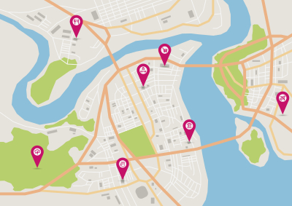
REVIEW
Maps and technology
Access an interactive map.
Can you see the scale?
What happens to the scale when you zoom in or out?
Pick two places on the map and use the scale to estimate the distance between them.
Notes:
Learners can access an interactive map on their phones or the tutor can demonstrate on the board.

Slide 12
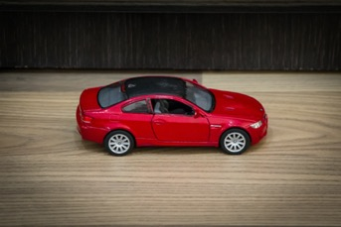
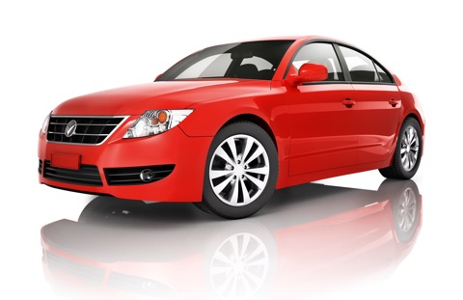
EXPLORE 6
Models and scales
Match the scales to the measurements of the lengths of these cars and their models.
There is a missing scale and a missing measurement.
1:40
Model: 15 cm Car: 3 m
1:24
Model: Car:
1:20
Model: 12 cm Car: 3.6 m
:
Model: 18 cm Car: 4.32 m
1:15
Model: 8 cm Car: 3.2 m
Notes:
Encourage learners to draw ratio tables to help them work out the matches.
For the missing Model/Car measurement students will have to pick their own Model measurement and use that and the scale to find the Car measurement.

Slide 13
REVIEW
Models and scales: answers
Match the scales to the measurements of the lengths of these cars and their models.
There is a missing scale and a missing measurement.
1:40
Model: 15 cm Car: 3 m
1:24
Model: Car:
1:20
Model: 12 cm Car: 3.6 m
:
Model: 18 cm Car: 4.32 m
1:15
Model: 8 cm Car: 3.2 m

Slide 14
REVIEW
1:40
cm
cm
1
2
4
8
40
80
160
320
cm
m
100
10
320
1
0.1
3.2
Notes:
Using a ratio table to illustrate the conversion will allow learners to work well without a calculator and will underpin their understanding of converting between metric units.
Ask questions such as:
Would you use all of these steps?
What could you do differently?
This allows learners to really think about the relationship of the numbers with a simpler example before moving on to the more difficult tasks coming up.
A ratio table is used to illustrate approaches. It is important to reiterate that this used for illustration of a range of approaches. Although the ratio table is provided it is only intended to be used to capture learners’ thinking, not as a ‘method’. The ratio table does, however, suggest multiplicative approaches and is encouraged to be used, along with their own diagrams, if appropriate, to capture your learners’ thinking. What is important is that they understand what they, and their peers, have done.

Slide 15
REVIEW
1:24
cm
cm
1
10
8
18
24
240
192
432
cm
m
100
10
432
1
0.1
4.32
Notes:
Using a ratio table to illustrate the conversion will allow learners to work well without a calculator and will underpin their understanding of converting between metric units.
Ask questions such as:
Would you use all of these steps?
What could you do differently?
This allows learners to really think about the relationship of the numbers with a simpler example before moving on to the more difficult tasks coming up.
A ratio table is used to illustrate approaches. It is important to reiterate that this used for illustration of a range of approaches. Although the ratio table is provided it is only intended to be used to capture learners’ thinking, not as a ‘method’. The ratio table does, however, suggest multiplicative approaches and is encouraged to be used, along with their own diagrams, if appropriate, to capture your learners’ thinking. What is important is that they understand what they, and their peers, have done.

Slide 16
REVIEW
1:20
cm
cm
1
10
5
15
20
200
100
300
cm
m
100
300
1
3
Notes:
Using a ratio table to illustrate the conversion will allow learners to work well without a calculator and will underpin their understanding of converting between metric units.
Ask questions such as:
Would you use all of these steps?
What could you do differently?
This allows learners to really think about the relationship of the numbers with a simpler example before moving on to the more difficult tasks coming up.
A ratio table is used to illustrate approaches. It is important to reiterate that this used for illustration of a range of approaches. Although the ratio table is provided it is only intended to be used to capture learners’ thinking, not as a ‘method’. The ratio table does, however, suggest multiplicative approaches and is encouraged to be used, along with their own diagrams, if appropriate, to capture your learners’ thinking. What is important is that they understand what they, and their peers, have done.

Slide 17
REVIEW
1:12
cm
cm
1
10
30
12
120
360
cm
m
100
10
360
1
0.1
3.6
Notes:
Using a ratio table to illustrate the conversion will allow learners to work well without a calculator and will underpin their understanding of converting between metric units.
Ask questions such as:
Would you use all of these steps?
What could you do differently?
This allows learners to really think about the relationship of the numbers with a simpler example before moving on to the more difficult tasks coming up.
A ratio table is used to illustrate approaches. It is important to reiterate that this used for illustration of a range of approaches. Although the ratio table is provided it is only intended to be used to capture learners’ thinking, not as a ‘method’. The ratio table does, however, suggest multiplicative approaches and is encouraged to be used, along with their own diagrams, if appropriate, to capture your learners’ thinking. What is important is that they understand what they, and their peers, have done.

Slide 18
REVIEW
1:15: multiple solutions
cm
cm
1
10
20
30
15
150
300
450
cm
m
100
10
450
1
0.1
4.5
Notes:
Using a ratio table to illustrate the conversion will allow learners to work well without a calculator and will underpin their understanding of converting between metric units.
Ask questions such as:
Would you use all of these steps?
What could you do differently?
This allows learners to really think about the relationship of the numbers with a simpler example before moving on to the more difficult tasks coming up.
A ratio table is used to illustrate approaches. It is important to reiterate that this used for illustration of a range of approaches. Although the ratio table is provided it is only intended to be used to capture learners’ thinking, not as a ‘method’. The ratio table does, however, suggest multiplicative approaches and is encouraged to be used, along with their own diagrams, if appropriate, to capture your learners’ thinking. What is important is that they understand what they, and their peers, have done.

Slide 19
REVIEW
Exam question 1
The diagram shows two places on a map.
X Shelton
X Trilby
Scale: 1 centimetre represents 20 kilometres
What is the actual distance, in kilometres, from Shelton to Trilby?
On a scale drawing, the scale is given as 1:1200
How many metres does 5 centimetres represent on this drawing?
Notes:
Again, encourage learners to draw ratio tables to convince themselves they have got the answer correct.

Slide 20
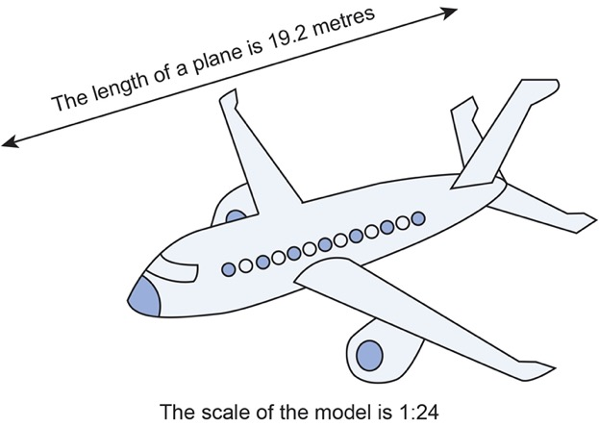
REVIEW
Exam question 2
The length of a plane is 19.2 metres.
Lukas buys a scale model of the plane.
The scale of the model is 1:24
Work out the length of the scale model of the plane.
Give your answer in centimetres.

Slide 21
REVIEW
Exam question 1: answers
The diagram shows two places on a map.
X Shelton
X Trilby
Scale: 1 centimetre represents 20 kilometres
What is the actual distance, in kilometres, from Shelton to Trilby?
50
kilometres
On a scale drawing, the scale is given as 1:1200
How many metres does 5 centimetres represent on this drawing?
60
metres

Slide 22
REVIEW
Exam question 2: answers
The length of a plane is 19.2 metres.
Lukas buys a scale model of the plane.
The scale of the model is 1:24
Work out the length of the scale model of the plane.
Give your answer in centimetres.
m
m
1
0.5
0.05
0.25
0.8
24
12
1.2
6
19.2
80
centimetres

Slide 23
Lesson review:
5 Scale, maps and units
Objectives
To be able to convert metric units of measurement
To be able to use a scale to find lengths
To be able to represent a proportional situation in a ratio table.
Suggested further steps/areas to work on
Converting between imperial units and metric units.

Slide 24

Lesson 5: Scale, Maps and Units
Credits
Photos
123RF.com: rawpixel, Shpadaruk Aleksei Shutterstock.com: Luke Broughton, Maria Kazanova, Emin Rzayev.
Text Acknowledgements
Pearson Education Ltd: Pearson Edexcel GCSE (9-1) In Mathematics (1MA1) Foundation (Calculator) November 2021 Paper 3F Pearson Education Ltd: Pearson Edexcel GCSE (9-1) In Mathematics (1MA1) Foundation (Calculator) November 2019 Paper 2F

