Slide 1


Lesson 3:
Direct proportion
Objectives
Identify when two quantities differ in direct proportion to one another
Understand the multiplicative relationship between two quantities (non- calculator)
Solve simple proportional problems using efficient methods with ratio tables
Notes:
Tutor guidance for lesson introduction:
Ask a confident/fluent learner to read the lesson objectives to the group.
Reiterate and clarify learning objectives.

Slide 2
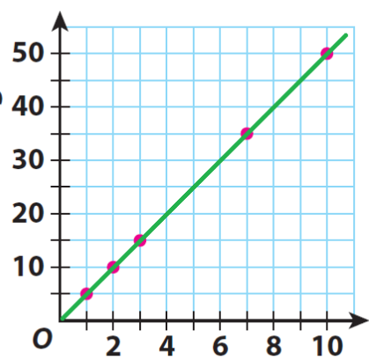
INTRODUCTION
Graph to show …?
1. Consider a label for the y-axis
?
2. Think of a title for this graph
3. Explain how the plotted points are related?
Number of people
Notes:
Tutor guidance: 15-minute exercise
Present information for individual and/or small group work.
Encourage learners to discuss and share ideas in their groups, agree on a y-axis label and include units.
Allow a minute for individuals/groups to decide.
Learners share their idea choices with the class (5–10 minutes)

Slide 3
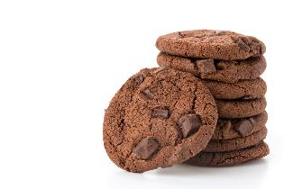
INTRODUCTION
Amount of cocoa powder (in grams) needed for each chocolate cookie per person
Number of people | 1
Cocoa powder (g) | 5
2
10
3
15
7
35
10
50
?
?
Cocoa powder
(grams)
Number of people
Notes:
Tutor guidance: 15-minute exercise
Present graph title and y-axis label to learners.
Allow exploration, through discussion, of what direct proportion means.
Reveal table of plotted values using learner responses (e.g., “Learner A, can you determine the grams of cocoa powder needed for 3 people, from the graph and/or ratio table?”)
Emphasise the proportional relationship between the number of people and the grams of cocoa.
Highlight the constant of proportionality in both horizontal and vertical approaches – noting that in either approach a multiplicative calculation is required.
Use "?" column to explore an extrapolated number of people for learners to use horizontal or vertical multiplication.
Allow 5 minutes for individuals/groups to decide on definition/meaning of direct proportion.
Learners share their definitions with the group and key words/phrases are placed on the board. (5–15 minutes)

Slide 4

Direct proportion
KEY IDEA
If two quantities are in direct proportion:
As one value gets bigger, so does the other (by the same multiplier).
A​s one value gets smaller, so does the other (by the same divisor).
If one value is 0, then the other value is 0.
Notes:
Share a formal definition of direct proportion with learners.
Explore values from 0 and link these to people vs cocoa (grams).
Contextualise as required.

Slide 5
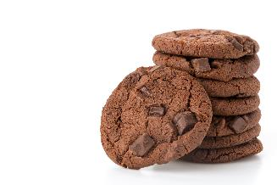
Investigating Recipes
INVESTIGATE
No. of Cookies | 12
Flour | 300 g
Sugar | 150 g
Butter | 200 g
Cocoa powder | 60 g
Here are the ingredient proportions in grams required to make 12 cookies.
Notes:
Tutor guidance (slides 5 and 6): 15-minute exercise
Present this information outlining full recipe for 12 cookies.

Slide 6


Investigating Recipes
EXPLORE 1
Handout
available
No. of Cookies | 12
Flour | 300 g
Sugar | 150 g
Butter | 200 g
Cocoa powder | 60 g
Using this recipe, how much of each ingredient would you need to make a different number of chocolate cookies?
Fill in as many columns as you can – without using a calculator
Notes:
Tutor guidance:
Offer learners blank copies the of table presented in this slide, Handout 1: Recipes.
Ask learners to complete as many columns as possible for the full recipe of a different number of cookies using the recipe given to them for 12.
If weaker learners need more scaffolding, offer this help while circulating in class, by filling in the top row of recipe for making 6, 3 and 24 cookies (pre-selected values).
Encourage completion without a calculator in the first instance.

Slide 7

Investigating Recipes
INVESTIGATE
Handout
available
6
No. of Cookies | 12 |  |  |  |  | 18
Flour | 300 g
Sugar | 150 g
Butter | 200 g
Cocoa powder | 60 g
÷2
150 g
75 g
100 g
30 g
How much of each ingredient would be required to make 18 cookies?
Notes:
Tutor guidance:
Use chocolate cookie recipe (unless not explored already with learner examples) to ask learners to find recipe for 18 chocolate cookies.
Explore 12 + 6 method (slide 7 – slide 23).
Use learner feedback to explore any other methods learners can think of (unitary method, multiplicative method e.g., 18/12 = 1.5, vertical multiplier(s)). Ask learners whether they have used a different approach to that used above when solving proportion problems. How has their thinking changed? What have they learned about multiplicative structure?

Slide 8
Investigating Recipes
INVESTIGATE
12 + 6 = 18
No. of Cookies | 12 | 6 |  |  |  | 18
Flour | 300 g | 150 g
Sugar | 150 g | 75 g
Butter | 200 g | 100 g
Cocoa powder | 60 g | 30 g
+
450 g
+
225 g
+
300 g
+
90 g
How much of each ingredient would be required to make 18 cookies?
Notes:
Tutor guidance:
Use chocolate cookie recipe (unless not explored already with learner examples) to ask learners to find recipe for 18 chocolate cookies.
Explore 12 + 6 method (slide 7 – slide 23).
Use learner feedback to explore any other methods learner can think of (unitary method, multiplicative method e.g., 18/12 = 1.5, vertical multiplier(s)). Ask learners whether they have used a different approach to that used above when solving proportion problems. How has their thinking changed? What have they learned about multiplicative structure?

Slide 9

Investigating Recipes
INVESTIGATE
No. of Cookies | 12 | 6 |  |  | 15 | 18
Flour | 300 g | 150 g |  |  |  | 450 g
Sugar | 150 g | 75 g |  |  |  | 225 g
Butter | 200 g | 100 g |  |  |  | 300 g
Cocoa powder | 60 g | 30 g |  |  |  | 90 g
How much of each ingredient would be required to make 15 cookies?
Notes:
Tutor guidance:
Use chocolate cookie recipe (unless not explored already with learner examples) to ask learners to find recipe for 15 chocolate cookies.
Explore 12 + 6 method (slide 7 – slide 23).
Use learner feedback to explore any other methods learners can think of (unitary method, multiplicative method e.g., 18/12 = 1.5, vertical multiplier(s)). Ask learners whether they have used a different approach to that used above when solving proportion problems. How has their thinking changed? What have they learned about multiplicative structure?

Slide 10

Investigating Recipes
INVESTIGATE
12 + 3 = 15
No. of Cookies | 12 | 6 | 3 |  | 15 | 18
Flour | 300 g | 150 g |  |  |  | 450 g
Sugar | 150 g | 75 g |  |  |  | 225 g
Butter | 200 g | 100 g |  |  |  | 300 g
Cocoa powder | 60 g | 30 g |  |  |  | 90 g
÷2
75 g
375 g
37.5 g
187.5 g
50 g
250 g
15 g
75 g
How much of each ingredient would be required to make 15 cookies?
Notes:
Tutor guidance:
Use chocolate cookie recipe (unless not explored already with learner examples) to ask learners to find recipe for 15 chocolate cookies.
Explore 12 + 6 method (slide 7 – slide 23).
Use learner feedback to explore any other methods learners can think of (unitary method, multiplicative method e.g., 18/12 = 1.5, vertical multiplier(s)). Ask learners whether they have used a different approach to that used above when solving proportion problems. How has their thinking changed? What have they learned about multiplicative structure?

Slide 11
EXPLORE 2
Handout
available
PRACTICE
Use the ratio tables on the handout to answer the questions.
Ensure you show your working out.
An object is moving with a velocity that changes proportionally with time. After 5 seconds its velocity is 105 m/s.
(a) How fast will it be travelling after 12 seconds?
Velocity (m/s) | 105
Time (s) | 5 |  |  |  | 12
(b) How fast will it be travelling after 4 seconds?
Velocity (m/s) | 105
Time (s) | 5 |  |  | 4
(c) How fast will it be travelling after 2 minutes and 13 seconds?
Velocity (m/s) | 105
Time (s) | 5 |  |  |  |  | 133
Notes:
Tutor guidance:
Ask learners to work in pairs and give each pair a copy of the Handout 2: Procedural variation. It is important that learners answer the questions in order, because they have been carefully designed to guide them to complete the table in a way that explores different relationships in a sequential way. Ask them not to be tempted just to fill in the table.
Make sure that learners explain their approach to their partner, working together to agree on a solution and to develop their own understanding. If you notice that one learner is answering all the questions, or that they are not working collaboratively, ask a learner to explain a question that has been answered by their partner.
Observe learners as they complete this task but do not intervene unless necessary. As learners work on the task, notice how they illustrate their strategy. As you observe them, identify those with different approaches. You can call on them to explain their thinking in the next part of the lesson.

Slide 12
Answers
Handout
available
An object is moving with a velocity that changes proportionally with time. After 5 seconds its velocity is 105 m/s.
(a) How fast will it be travelling after 12 seconds?
Velocity (m/s) | 105 | 210 | 21 | 42 | 252
Time (s) | 5 | 10 | 1 | 2 | 12
(b) How fast will it be travelling after 4 seconds?
Velocity (m/s) | 105 | 21 | 42 | 84
Time (s) | 5 | 1 | 2 | 4
(c) How fast will it be travelling after 2 minutes and 13 seconds?
Velocity (m/s) | 105 | 210 | 630 | 2100 | 63 | 2793
Time (s) | 5 | 10 | 30 | 100 | 3 | 133

Slide 13
True or false?
YOUR
TURN
Handout
available
No. of Cookies | 10 | 25
Cocoa powder | 40 g | 55 g
+ 30
+ 30
No. of Cookies | 10 | 20 | 25
Cocoa powder | 40 g | 80 g | 85 g
×2
+ 5
×2
+5
Ratio tables work both vertically and horizontally – multiplicatively!
Notes:
Tutor guidance:
Learners explore the multiplicative relationship between columns and rows to decide whether the graphic shown for calculating direct proportion is true or false in each instance.
Open discussion to highlight this common misconception – that learners calculate differences between adjacent columns and/or rows by using addition and/or multiplication.

Slide 14
True or false?
YOUR
TURN
Handout
available
No. of Cookies | 12 | 6
Cocoa powder | 60 g | 30 g
×5
×5
No. of Cookies | 12 | 6
Cocoa powder | 60 g | 30 g
÷2
÷2
Ratio tables work both vertically and horizontally – multiplicatively!
Notes:
Tutor guidance:
Allow learners to explore the multiplicative relationship between these columns and rows to decide whether the graphic shown is a true or a false representation for calculating direct proportion.

Slide 15
True or false?
REVIEW
Handout
available
No. of Cookies | 10 | 25
Cocoa Powder | 40 g | 55 g
+ 30
+ 30
False
No. of Cookies | 10 | 20 | 25
Cocoa Powder | 40 g | 80 g | 85 g
False
×2
+ 5
×2
+ 5
Ratio tables work both vertically and horizontally – multiplicatively!
Notes:
Tutor guidance:
Learners explore the multiplicative relationship between columns and rows to decide whether the graphic shown for calculating direct proportion is true or false in each instance.
Open discussion to highlight this common misconception - that learners calculate differences between adjacent columns and/or rows by using addition and/or multiplication.

Slide 16
True or false?
REVIEW
Handout
available
No. of Cookies | 12 | 6
Cocoa powder | 60 g | 30 g
×5
×5
True
No. of Cookies | 12 | 6
Cocoa powder | 60 g | 30 g
÷2
True
÷2
Ratio tables work both vertically and horizontally – multiplicatively!
Notes:
Tutor guidance:
Allow learners to explore the multiplicative relationship between these columns and rows to decide whether the graphic shown is a true or a false representation for calculating direct proportion.

Slide 17
Clarifying misconceptions
REVIEW
No. of Cookies | 12 | 6 | 1
Cocoa powder | 60 g | 30 g | 5 g
Finding the multiplier:
×5
×5
×5
60 ÷ 12 = 5
60 grams for 12 cookies, so 5 grams for a single cookie.
Divide the gram quantity by the number of cookies to determine the multiplier value.
No. of Cookies | 12 | 6
Cocoa powder | 60 g | 30 g
÷2
How would you describe the
relationship in the table?
÷2
Ratio tables work both vertically and horizontally – multiplicatively!
Notes:
Tutor guidance:
Allow learners time to explore the multiplicative relationship between columns and rows to decide whether this statement is true or false in all instances.

Slide 18

Spot the error
EXPLORE
Here are the ingredients needed to make a tray of 20 flapjacks:
200 g of margarine
250 g of oats
200 g of sugar
100 g of flour
3 tablespoons of syrup
Kelly needs to make 50 flapjacks for a party.
How much flour does she need?
×2
+10
No. of flapjacks | 20 | 40 | 50
Flour (g) | 100 | 200 | 210
x 2
+10
Notes:
Tutor guidance:
Learners explore the relationship between the number of flapjacks and grams of flour required.
Can they spot the error and offer suggestions on how this could be rectified?
Use sugar, oats and syrup measures to extend this exercise.

Slide 19
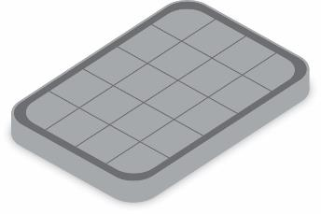
Spot the error
EXPLORE
Here are the ingredients needed to make a tray of 20 flapjacks:
200 g of margarine
250 g of oats
200 g of sugar
100 g of flour
3 tablespoons of syrup
Kelly needs to make 50 flapjacks for a party.
How much flour does she need?
÷2
×2
No. of flapjacks | 20 | 40 | 10 | 50
Flour (g) | 100 | 200 | 50 | 250
× 2
÷2
Notes:
Tutor guidance:
Learners explore the relationship between the number of flapjacks and grams of flour required.
Can they spot the error and offer suggestions on how this could be rectified?
Use sugar, oats and syrup measures to extend this exercise.

Slide 20

Practice questions
REVIEW
Handout
available
There are 84 calories in 100 g of banana.
There are 87 calories in 100 g of yogurt.
Priti has 60 g of banana and 150 g of yogurt for breakfast.
Work out the total number of calories in this breakfast.
Banana (g) | 100
Calories
Yogurt (g)
Calories | 87
180.9
Notes:
Learners should work on this question individually or in pairs. Encourage them to use ratio tables to carry out their calculations, but they can use whatever methods they wish. When learners have completed the question, ask them to share their methods and reveal the answer. Slide 22 provides one way of using a ratio table for this question, but there are many valid alternatives – encourage learners to share these.

Slide 21

Practice questions
REVIEW
Handout
available
Scott wants to make orange juice.
He is going to buy boxes of oranges.
30 oranges make 2 litres of orange juice.
Scott needs to buy enough oranges to make 8 litres of orange juice.
Work out the number of boxes of oranges that Scott needs to buy.
Number of litres | 2 |  |  | 8
Number of oranges | 30
Number of boxes | 1
Number of oranges | 24
5
Notes:
Learners should work on this question individually or in pairs. Encourage them to use ratio tables to carry out their calculations, but they can use whatever methods they wish. When learners have completed the question, ask them to share their methods and reveal the answer. Slide 23 provides one way of using a ratio table for this question, but there are many valid alternatives – encourage learners to share these.

Slide 22
PRACTICE
÷10
×6
Grams | 100 | 10 | 60
Banana | 84 | 8.4 | 50.4
÷10
×6
÷10
×5
Grams | 100 | 10 | 50 | 150
Yogurt | 87 | 8.7 | 43.5 | 130.5
50.4 + 130.5 = 180.9 calories
÷10
×5
Notes:
Tutor guidance:
Learners explore the relationship between the number of calories per gram of banana and number of calories per gram of yogurt.
Can they spot the error and offer suggestions on how this could be rectified?

Slide 23
PRACTICE
x2
x2
Oranges | 30 | 60 | 120
Litres | 2 | 4 | 8
x 2
x 2
No. of boxes | 1 | 2 | 4 | 5
Oranges | 24 | 48 | 96 | 120
Notes:
Tutor guidance:
Learners explore the relationship between the number of boxes of oranges and litres of juice required.
Can they spot the error and offer suggestions on how this could be rectified?

Slide 24
REVIEW
Amount of cocoa powder (in grams) needed for each chocolate cookie per person
How can the information presented in this graph help to find, for example, the amount of Cocoa powder for 17 people?
Cocoa powder
(grams)
Number of people
Notes:
Tutor guidance:
Individual and small group work will allow learners to discuss and share ideas on how to calculate the quantity of cocoa powder for a given number of people.
Target questions to consolidate learners’ knowledge on the proportional relationship between x and y values.

Slide 25
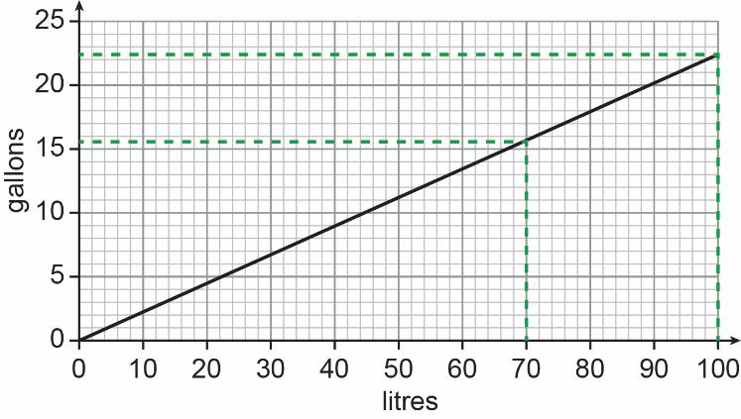
REVIEW
This graph can be used to convert between gallons and litres.
How can the information presented in this graph help in calculating the number of gallons equivalent to 170 litres?
Notes:
Tutor guidance:

Slide 26
Lesson review:
3 Direct proportion
Objectives
Identify when two quantities differ in direct proportion to one another
Understand the multiplicative relationship between two quantities (non-calculator)
Solve simple proportional problems using efficient methods with ratio tables
Suggested further steps/areas to work on
Conversion graphs

Slide 27


Lesson 3:
Credits
Text acknowledgements
Pearson Education Ltd: Pearson Edexcel
GCSE (9-1) In Mathematics (1MA1) Foundation (Calculator) Paper 2F, Q17, June 2019, (Non-Calculator) Paper 1F, Q17 November 2020.

